Slide 1






Publishing research articles
in Diamond Open Access
Marie Farge
CNRS-INSMI,
LMD-ENS Paris
and CAPSH
November 13th 2023,
CEIC-IMU meeting

Slide 2
1990s, Researchers designed their tools
In 1978, the computer scientist Donald Knuth (Stanford University)
published the Open Software TeX for typesetting research articles,
in particular for mathematical formulas.
In 1990, the physicist and computer scientist Tim Bernes-Lee (CERN)
created the Open Protocol http of WWW without patenting it
in order that it could be adopted by anyone.
In 1991, the physicist Paul Ginsparg (Los Alamos National Laboratory)
created the Open Platform ArXiv to share preprints for exact sciences,
the submission rate today is above 10 000 articles/month.
In 1994, the economist Michael Jensen (Harvard University)
created the Open Platform SSRN to share preprints for social sciences,
it was the largest repository in 2013 but Elsevier bought it in 2016.
In 1998, the education scientist John Willinsky (Simon Fraser University)
released the Open Software OJS to manage editing and peer-reviewing,
used today by more than 10 000 research journals.

Slide 3
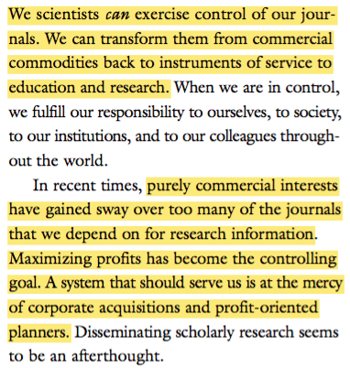
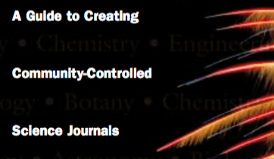
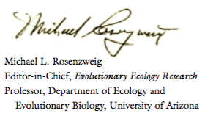
2001, SPARC declared independence
Declaration of SPARC (Scholarly Publishing and Academic Resources Coalition) :
http://openscience.ens.fr/ABOUT_OPEN_ACCESS/DECLARATIONS/

Slide 4
2002, Budapest Open Access Initiative
To achieve open access to scholarly journal literature,
we recommend two complementary strategies:
I. Self-Archiving: First, scholars need the tools and assistance to deposit their refereed journal articles in open electronic archives.
II. Open-access Journals: Second, scholars need the means to launch a new generation of journals committed to open access, and to help existing journals that elect to make the transition to open access.
These new journals will not charge subscription or access fees, and will turn to other methods for covering their expenses, including the foundations and governments that fund research, the universities and laboratories that employ researchers, endowments set up by discipline or institution, friends of the cause of open access, funds freed up by the demise or cancellation of journals charging traditional subscription or access fees.
There is no need to favor one of these solutions over the others for all disciplines or nations, and no need to stop looking for other creative alternatives.
http://openscience.ens.fr/ABOUT_OPEN_ACCESS/DECLARATIONS/

Slide 5
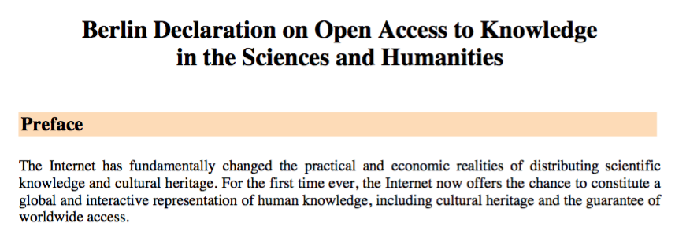
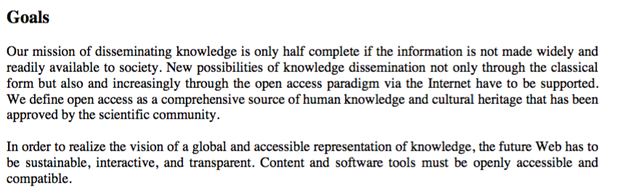
2003, Berlin Declaration on Open Access
http://openscience.ens.fr/ABOUT_OPEN_ACCESS/DECLARATIONS/

Slide 6
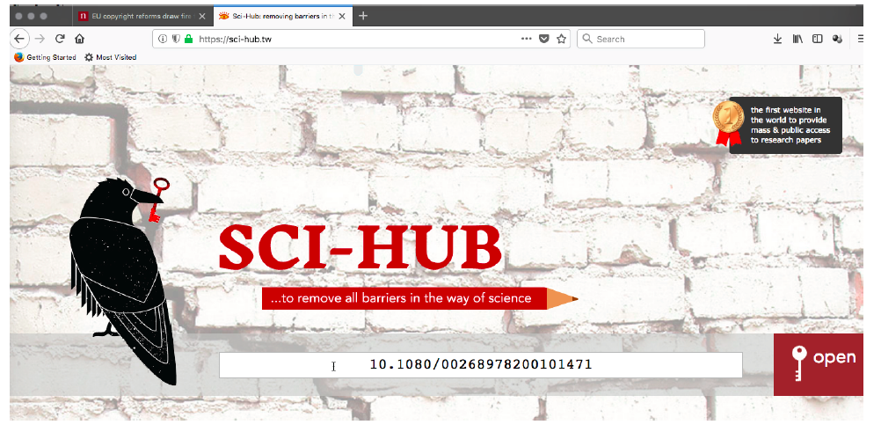
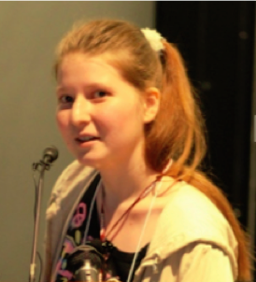
2011, a young researcher innovated
In 2011 Alexandra Elbakyan, researcher in neurosciences
working in Kazakhstan, created the largest platform for
freely accessing to more than 80 millions research articles.
When an article is behind a pay-wall
copy its DOI (Digital Object Identifier),
then open Sci-Hub and enter its DOI
http://openscience.ens.fr/OTHER/SCIHUB/

Slide 7
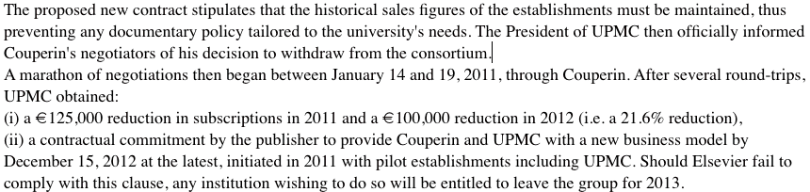
2011, How I learned about publishers
As member of the COMETS (Ethics Committee of CNRS), chaired by Jean-Pierre Bourguignon,
I wrote the `Recommendation on the relations between researchers and publishers’.
To this end, I interviewed librarians in charge of negotiations with publishers and lawyers
specializing in intellectual property. It was a shock for me to realize how brutal these
negotiations are and how dramatic the lack of information researchers have about them.
A researcher, Jacques Lafait, who advised the President of UPMC (Paris VI University), had
the courage to testify on the conflict his university had with Elsevier. In 2011 UPMC refused
to renew its subscription to Freedom Collection (bundle of all journals owned by Elsevier).
His testimony was appended to my report (but CNRS removed it from the published version):
http://openscience.ens.fr/MARIE_FARGE/ARTICLES/2011_06_27_AVIS_POUR_LE_COMITE_D_ETHIQUE_DU_CNRS

Slide 8
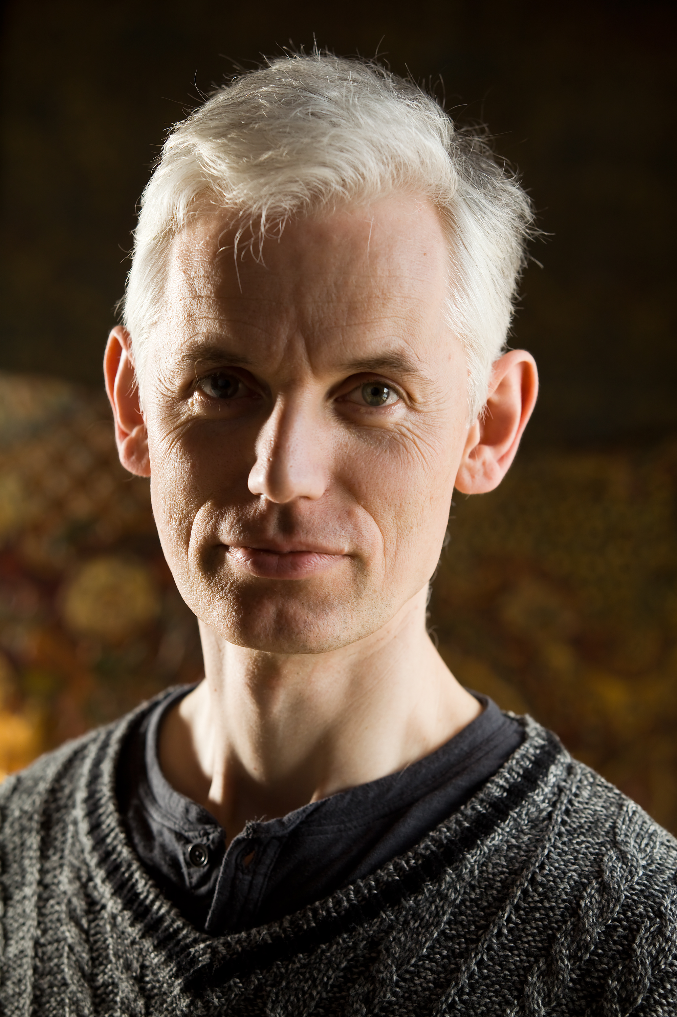
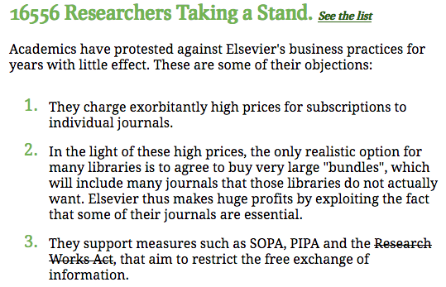
2012, some mathematicians revolted
On 9 February 2012, Tim Gowers and 33 mathematicians published The Cost of Knowledge
calling to boycott Elsevier and stop the Research Works Act, a bill in the U.S. Congress owed to Elsevier‘s request to repeal open accesss policies. On 27 February, Elsevier withdrew its support.
Tyler Neylon set up a website for researchers to sign up:
http://www.thecostofknowledge.com
Sir Tim Gowers,
Cambridge University
and Collège de France,
Fields medal 1998

Slide 9

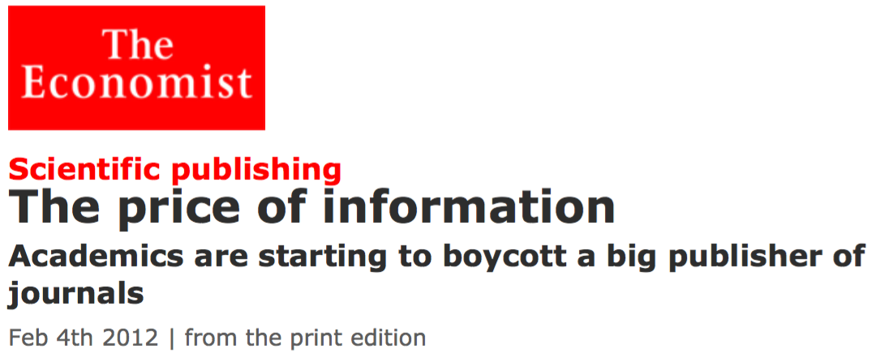
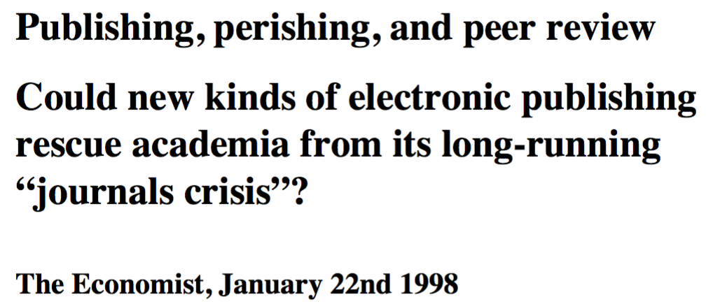
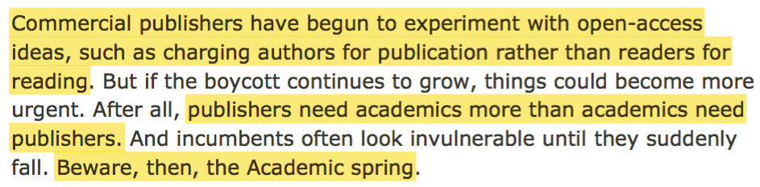
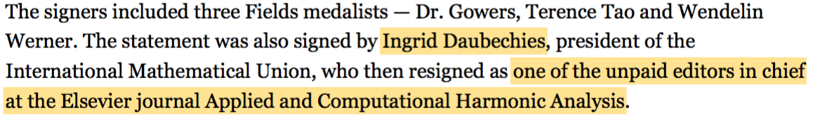


2012, press relayed CoK’s boycott
For many years economic press and finance experts have been observing researchers
as the goose that lays the golden eggs for publishers (up to 40% profits)…
22/1/1998
4/2/2012
13/2/2012
http://openscience.ens.fr/ABOUT_OPEN_ACCESS/ARTICLES/

Slide 10
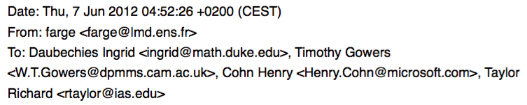

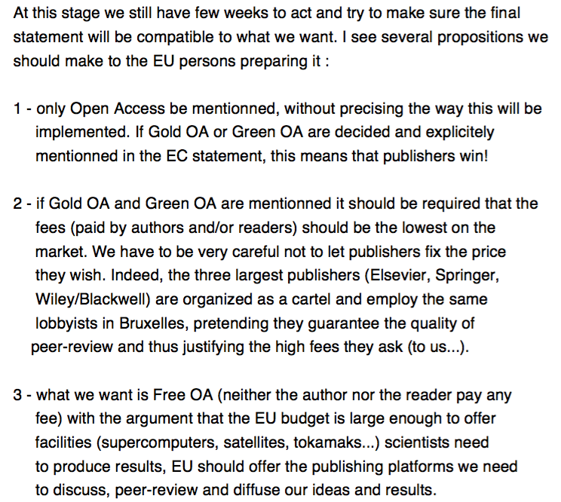
2012, CoK’s concern about EU policy

Slide 11
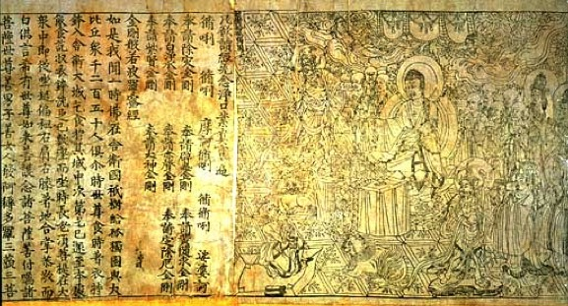
2012, CoK proposed Diamond OA
The Diamond Sutra of the British Library,
the oldest printed and dated text we know,
contains Bouddha teachings and mentions :
`On the 15th day of the 4th month of the 9th year
of the Xiantong reign period (11 May 868),
Wang Jie had it made for universal distribution
on behalf of his two parents.’
Since neither readers not authors had to pay,
I proposed to name this model Diamond OA.
It also outbids the Gold OA model of publishers
and May 2012 was Elizabeth II’s Diamond Jubilee.
Diamond Sutra is the oldest dated printed book:
printed with wooden blocks, dated 11th May 868,
discovered in 1900 in the Mogao Caves (China),
and brought to London in 1907.
https://www.bl.uk/collection-items/the-diamond-sutra
http://openscience.ens.fr/OPEN_ACCESS_MODELS/DIAMOND_OPEN_ACCESS/2012_06_07_Mail_Marie_Farge_to_Tim_Gowers_to_propose_Diamond_Open_Access.pdf
`Neither author nor reader should have to pay to publish and
a journal should no more belong to a publisher but to its editorial board.
Peer-reviewing and publishing are done using public infrastructures
where articles are archived and accessible online for free.’
June 29th 2012, Marie Farge, Note for the French minister of higher education and research :
http://openscience.ens.fr/MARIE_FARGE/ARTICLES/2012_06_29_NOTE_POUR_LA_MINISTRE_DE_LA_RECHERCHE

Slide 12
Diamond Open Access model
Authors deposit their preprint in an open repository (e.g., arXiv),
which is thus officially dated and published in open access for free.
Authors then submit their preprint to a journal to be peer-reviewed
(i.e., checked by referees, improved, revised) and published, if accepted.
If accepted, the article is published in open access with a CC-BY license,
which allows anyone to distribute it as long as its authors are credited.
Authors retain their copyright and don’t have to pay to publish.
https://creativecommons.org/licenses/
Editors collectively own the title and assets of the journal, because
they are responsible for peer review which requires a high level of expertise.
Editors and referees provide this service gratis as part of their academic duties.
Publishers are no longer the owners of peer-reviewed journals
but only service providers. Editors can thus choose on a competitive basis
among the various services offered by publishers, if they need them.
http://openscience.ens.fr/OPEN_ACCESS_MODELS/DIAMOND_OPEN_ACCESS/

Slide 13
Need for public publishing platforms
Funding agencies should provide for free to researchers
publicly-owned non-for-profit publishing platforms,
as infrastructures for research on the model of computing centers,
to peer review and publish research articles
with the help of librarians and publishers as service providers.
They should be developed using open source software
(e.g., Open Journal System or Invenio), in order to be able
so that new designs can be shared and best practice disseminated.
The governance of publishing platforms is an important issue,
which should be organized along the lines of computing centers,
with a scientific committee responsible for selecting journals
that are good enough to merit free publication. Such a selection helps
to control the quality of peer review, by selecting journals with
excellent practices and reputable editors with limited mandates.
Such publishing platforms would also provide researchers
tools to experiment new ways of peer-reviewing and publishing
(e.g., open peer review).

Slide 14


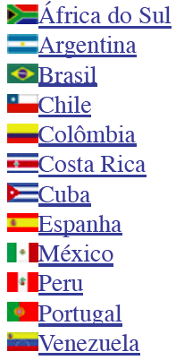

Public publishing platforms already existed
+
Created in 1997,
it publishes
1 458 journals
from 17 countries
in open access,
financed by public
agencies from Brazil
(FAPESP, CNPq,
CAPES) and from
other countries.
Created in 1999,
it publishes
586 journals, 12 851 books
in open access,
financed by public
agencies from France
(CNRS, EHESS, MESR,
Aix-Marseille and
Avignon universities).
+

Slide 15
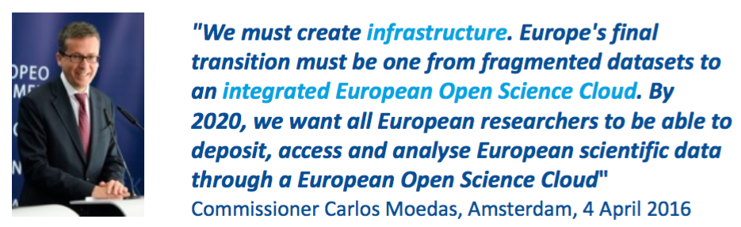
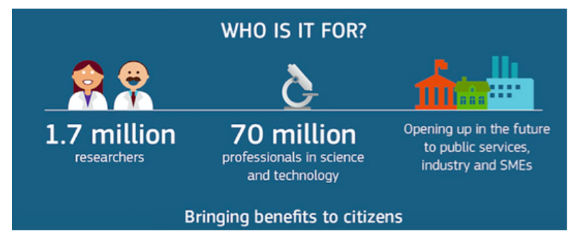
2016, Europe wants a legal Sci-Hub
On 4 April 2016 Carlos Moedas, the European commissioner
for research, science and innovation launched the Amsterdam Call :
http://openscience.ens.fr/DECLARATIONS/
2016_04_04_EC_Amsterdam_Call_for_Action_on_Open_Science.pdf

Slide 16
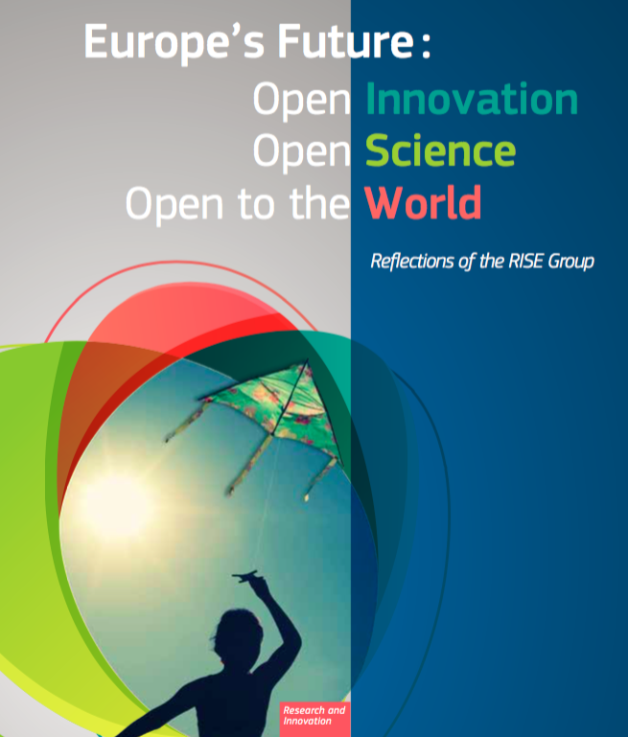
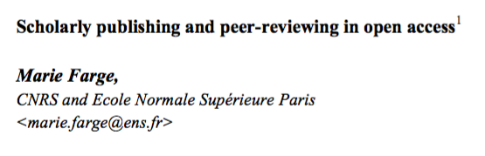
2017, OA peer-review and publishing
At the request of Carlos Moedas I wrote the chapter
on open access to peer-reviewed research publications
in a book published by the Commission in 2017.
I argued that research articles,
as well as peer review reports,
should be available free of charge,
for both authors and readers,
to ensure that published results have been
validated and are reproductible.
http://openscience.ens.fr/MARIE_FARGE_ARTICLES/
2017_05_15_BOOK_CHAPTER_FOR_THE_EUROPEAN_COMMISSION

Slide 17
2018, Creation of the Mersenne Center
The Mersenne center has been created in 2018 in Grenoble as part of Mathdoc,
a service unit of CNRS-INSMI and of the University of Grenoble,
as a Diamond Open Access platform for publishing and peer-review research journals
,.
Guiding principles:
- High quality of peer review,
- Non-profit public service,
- Perpetual archiving,
- Transparency of costs,
- Transparency of journal selection.
Type-setting is done with the open source software LaTeX,
while the editorial process and publication are done
with the open source software OJS (Open Journal System).
https://www.centre-mersenne.org/en/

Slide 18
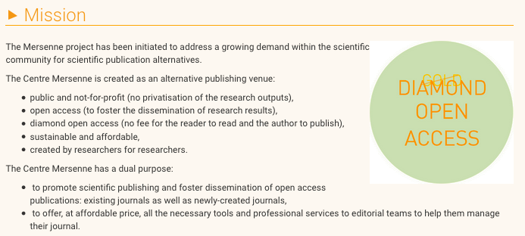





2018, Diamond OA platform Mersenne
Mersenne employs 15 part-time persons and its
production cost is on average 700 € per article and 35 €/pages,
which is financed by French public research funding institutions :
https://www.centre-mersenne.org/en/

Slide 19
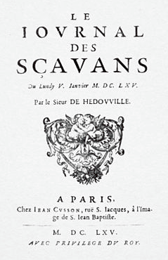
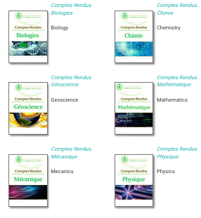
2020, CRAS left Elsevier for Mersenne
In 1665, creation of the
`Journal des Sçavans’.
In 1835, creation of the
`Comptes-Rendus de
l’Académie des Sciences’
(CRAS), which were published
by Gauthier-Villars.
In 2000, Elsevier bought
Gauthier-Villars.
5th January 1665
`It would be an excellent advertisement
for the Académie des Sciences de Paris
if its Comptes-Rendus were published
using the Diamond OA model.’
Marie Farge, Note for the French minister of research, 29 June 2012
http://openscience.ens.fr/MARIE_FARGE/ARTICLES/
2012_06_29_NOTE_POUR_LA_MINISTRE_DE_LA_RECHERCHE
Since 2020, CRAS are published,
no longer in Gold Open Access by Elsevier,
but in Diamond OA by the platform Mersenne.

Slide 20
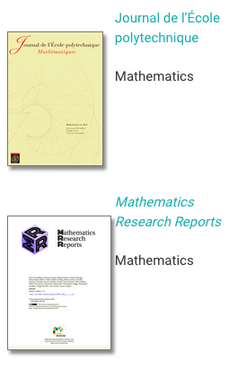
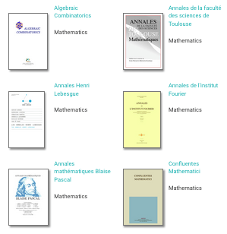
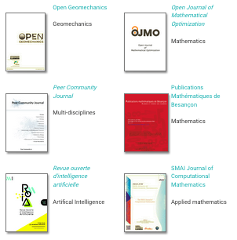
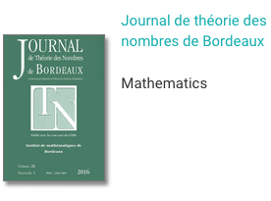
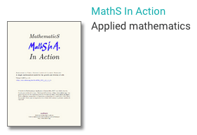
2023, Journals published by Mersenne
Mersenne also publish other journals (e.g., CRAS and Peer Community Journal)
together with conference proceedings, seminars and books.

Slide 21
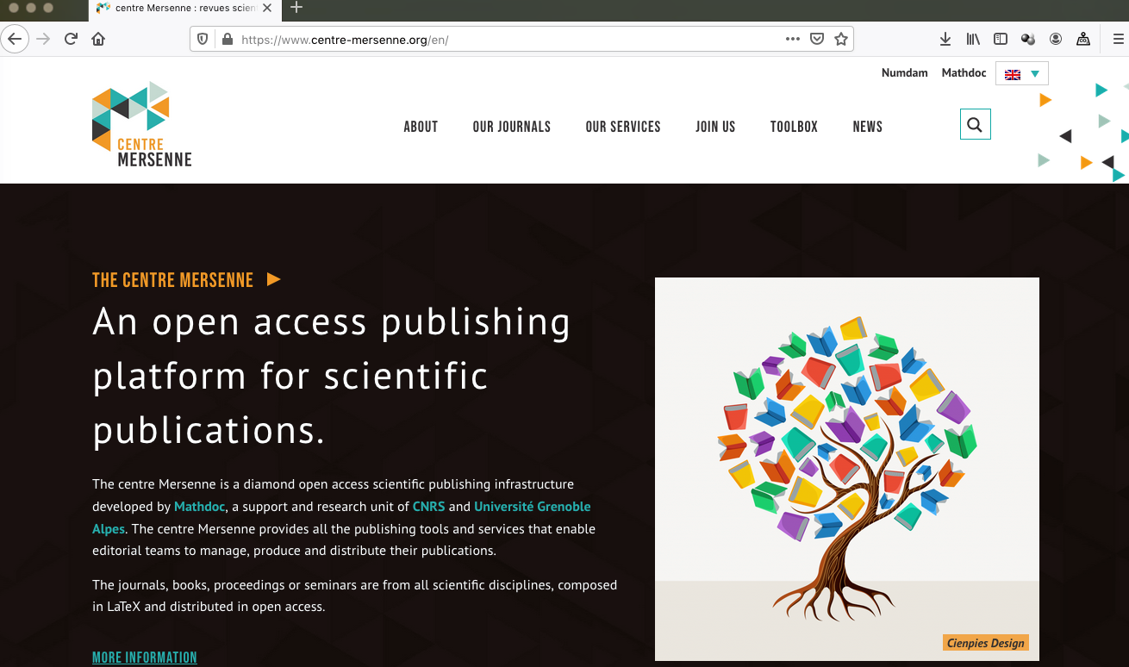
2023, new design of the Mersenne Platform
https://www.centre-mersenne.org/

Slide 22

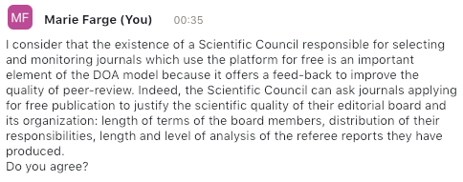
2023, Global Summit of Diamond OA

Slide 23
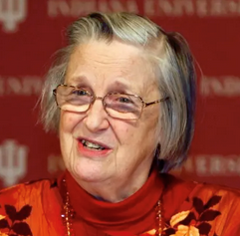
Conclusion
Ideas are not of the same nature as material products because
when you give an idea you do not lose it, therefore no need to be paid.
Sharing ideas is a positive-sum game, because you loose nothing while
if an idea is not shared, it is lost forever!
Knowledge is not a product to be traded, but a commons to be shared.
In 2009 Elinor Ostrom got the
Nobel prize in economic sciences for:
`her analysis of economic gouvernance,
especially the commons, showing how
common resources can be managed successfully
by the people who use them, rather than
by governments or private companies’.
Charlotte Hess and Elinor Ostrom,
Understanding knowledge as a Commons,
MIT Press, 2006

Slide 24
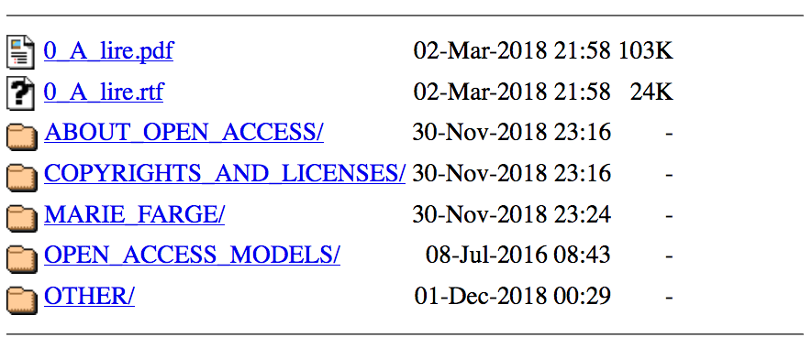
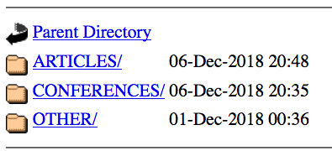
For more information about open access
http://openscience.ens.fr
http://openscience.ens.fr/MARIE_FARGE
https://dissem.in/

