Slide 1
Researchers regain control
of their publication means
Marie Farge
CNRS-INSMI et ENS Paris
Institute of Language, Communication and the Brain (ILCB)
Aix-Marseille Université (AMU)
March 28th 2019

Slide 2
Who has access to research articles ?
Only researchers working in institutions and countries rich enough
to afford the very costly subscriptions to academic journals.
Researchers working for companies or in poor institutions,
teachers, students, retired researchers and all citizens who finance
public research do not have access to most of the research articles.
By 2000 most of the renown scholarly journals have been bought
by few major publishers, whose exceptional profits rely on the work
that researchers and their funding agencies offer them for free.
Publishers benefit from the digital revolution and the Web to
to reduce production costs using online peer-reviewing and publishing,
but keep the business model designed for printing on paper.
Today few major publishers have acquired an oligopolistic position.

Slide 3
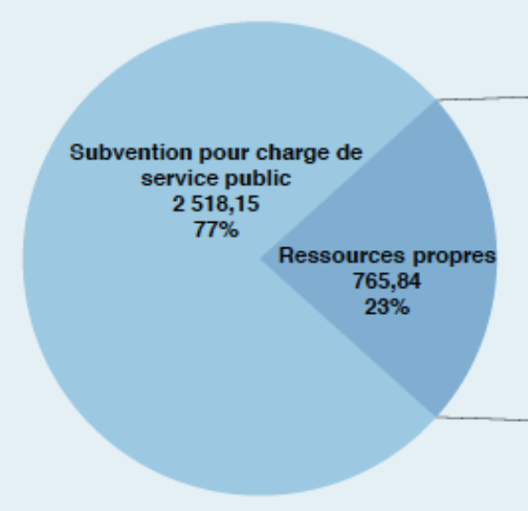
The oligopoly of academic publishers
Four private commercial companies control academic publishing :
Elsevier, Springer Nature, Wiley-Blackwell et Taylor&Francis (Informa).
>>
8.4 Billions €
turnover of Reed-Elsevier (RELX) in 2017
3.3 Billionss €
budget of CNRS
in 2017
http://www.elsevier.com
http://www.cnrs.fr/fr/le-cnrs

Slide 4
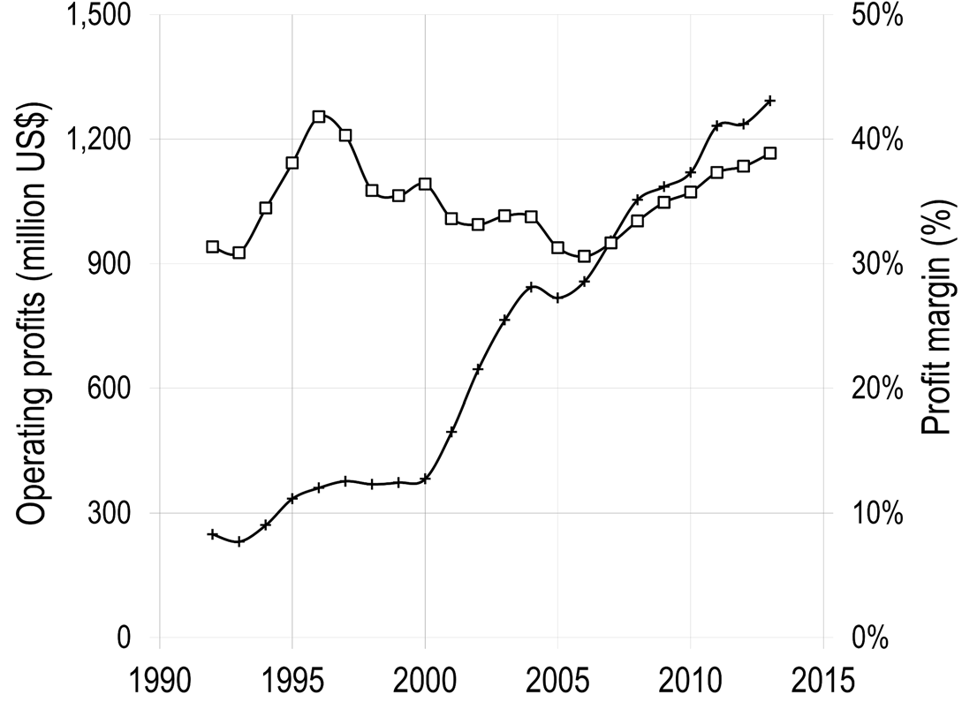
Operating profits and profit margin of the publisher Reed-Elsevier
for its Scientific, Technical and Medical (STM) division from 1990 to 2015
Operating profits
Profit margin
1.2 billion US$
Vincent Larivière et al., The Oligopoly of Academic Publishers, PLOS one, 10th June 2015

Slide 5
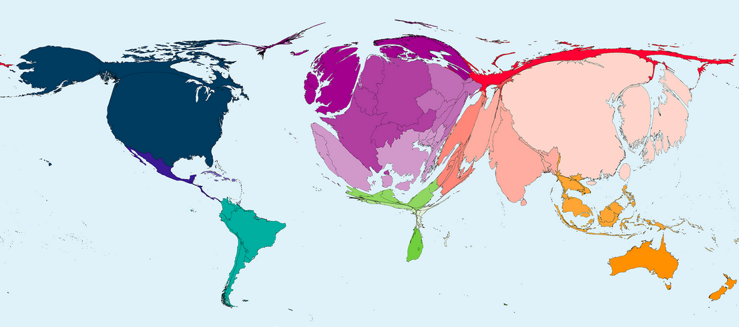
Gold Open Access is counter-productive
Number of research articles published in 2016 divided by the number of inhabitants per country
http://www.worldmapper.org
Publishers impose the Gold Open Access model, which flips subscription
into Article Publication Charges (APCs) one has to pay to publish.
research institutions will get bankrupted or stop publishing!

Slide 6
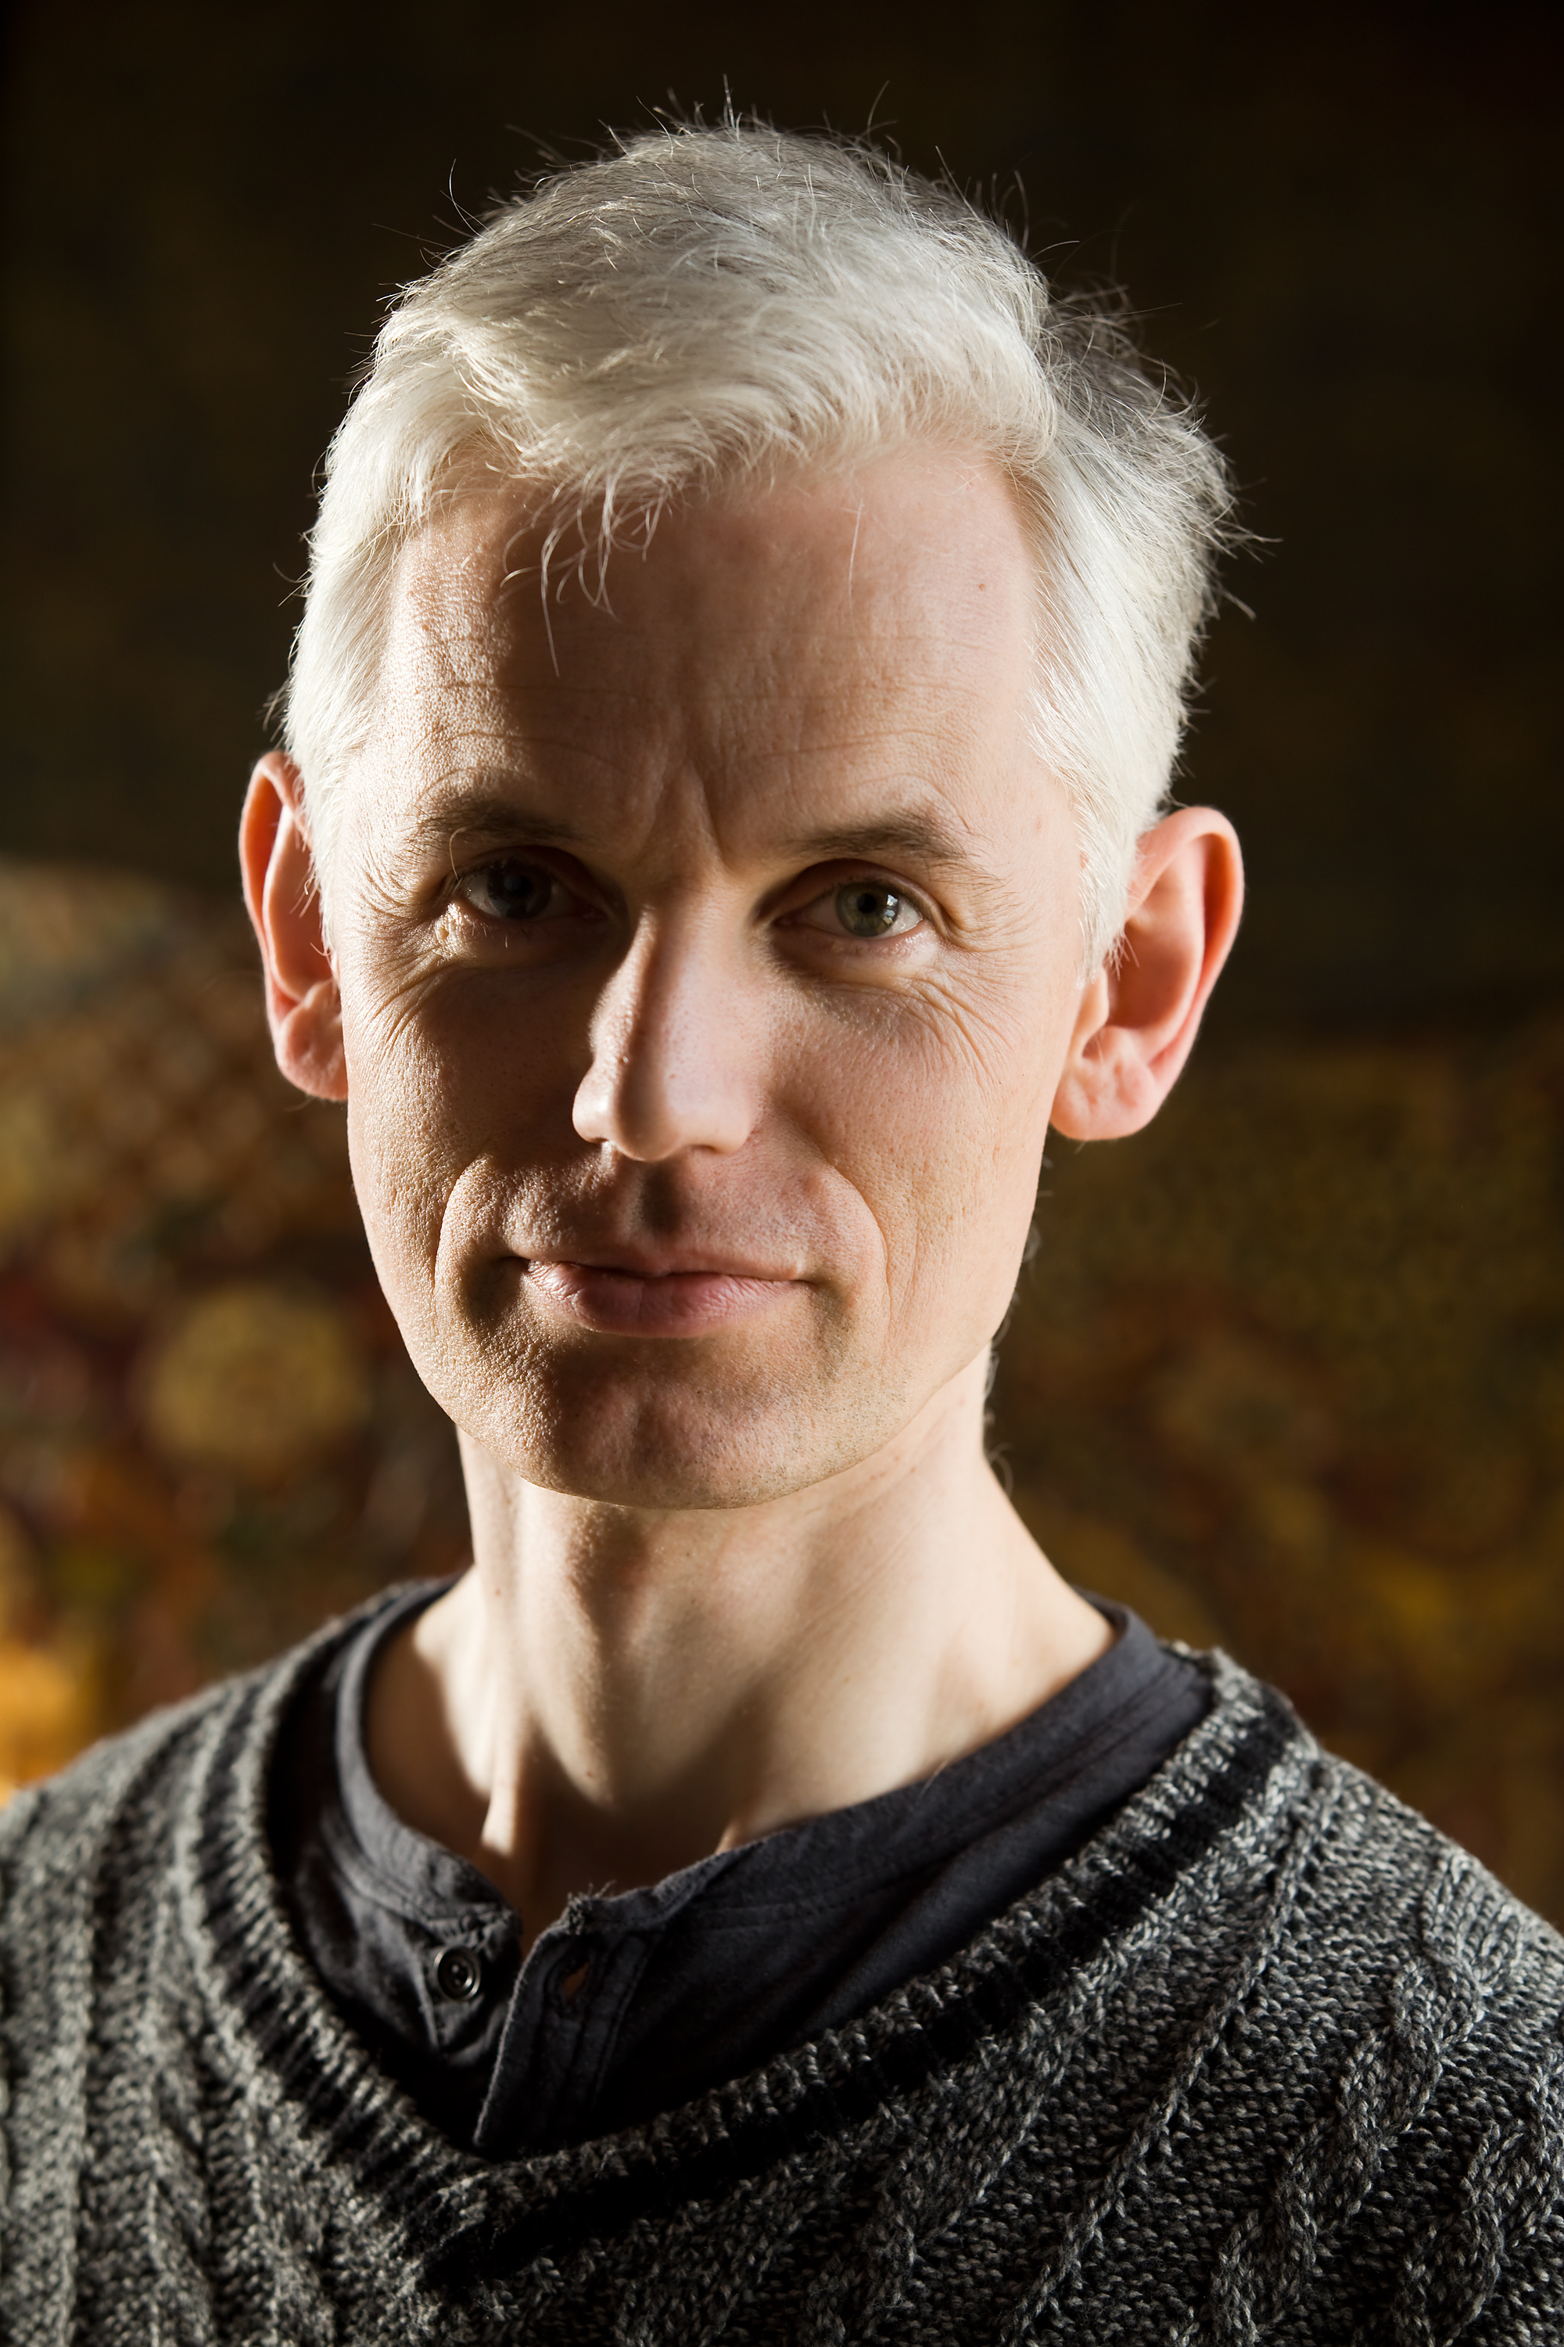
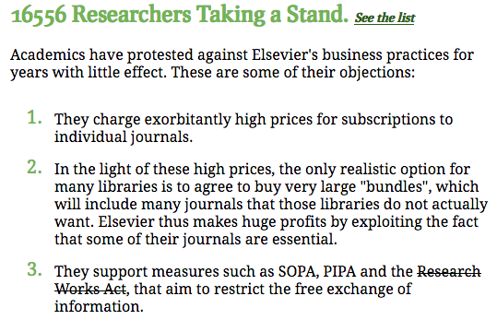
The Cost of Knowledge, 2012
In January 2012 Tim Gowers and 33 mathematician colleagues
called to boycott Elsevier and stopped the Research Works Act,
a bill to the US Congress Elsevier was lobbying for.
Sir Tim Gowers,
Cambridge University,
Fields medal 1998
http://www.thecostofknowledge.com/

Slide 7
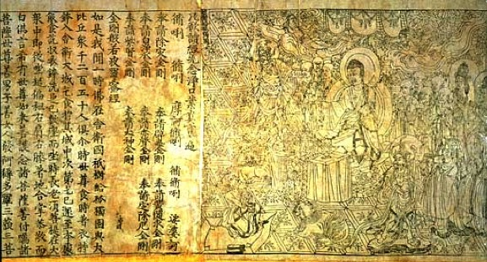
We want to recover control
`Neither author nor reader should have to pay to publish and
a journal should not belong to its publisher but to its editorial board.
The publishing of peer-reviewed articles should be done using
public infrastructures from where articles are accessible online for free.’
Marie Farge, Note for the French Minister of Research, June 29th 2012
http://openscience.ens.fr/MARIE_FARGE/
In 2012 CoK proposed
the alternative model,
Diamond Open Access
Named from the Diamond Sutra,
the earliest complete survival
of a dated printed book,
China, 11th May 868
British Library, London

Slide 8
We propose Diamond Open Access
1
Authors keep their copyright and allow
their articles to be published in Open Access
(under the Creative Commons license CC-BY).
https://creativecommons.org/licenses/
2
Editors of a peer-reviewed journal collectively own its title and assets,
since they are in charge of peer-reviewing the submitted articles
(editors and referees do this for free, as part of their academic duty).
3
Publishers no more own the peer-reviewed journals
but become service providers to their editors
(who select publishers on a competitive basis).

Slide 9
We need public publishing platforms
Funding agencies should provide, for free to researchers,
publicly-owned platforms, developed using open source software,
for peer-reviewing, publishing and archiving articles and data,
with the help of librarians and of publishers (as subcontractors).
Anyone from anywhere would have free (gratis and libre) access to peer-reviewed publications (e.g., articles, data, codes, videos)
without researchers having to pay to publish their results.
Funding agencies would thus control the quality of peer-reviewing,
by selecting the journals having good practices and reputable editors.
Such publishing platforms would give the chance to researchers
to experiment new ways of publishing (e.g., open peer-reviewing).

Slide 10
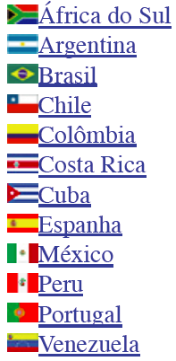
Examples of public publishing platforms
+
Created in 1999,
it publishes
1249 journals
in open access,
financed by public
agencies from Brazil
(FAPESP, CNPq,
BIREME) and from
15 other countries.
Created in 1999,
it publishes
451 journals
in open access,
financed by public
agencies from France
(CNRS, EHESS, BSN,
Aix-Marseille and
Avignon universities).
+

Slide 11
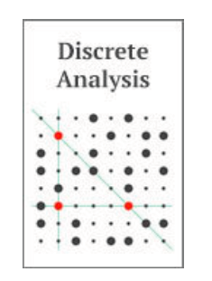
Examples of Diamond OA journals
1
//www.ipol.im ISSN : 2105-1232 DOI : 10.5201/ipol
Founded in 2010 by Jean-Michel Morel, IPOL has 41 editors.
It is financed by CNES, ERC and 13 public institutions from 5 countries.
Each article contains the text, the algorithm and the source code,
which all are peer reviewed. The journal platform also provides
online demonstration facility and an archive of experiments.
IPOL thus ensures open science and reproducible research.
2
http://discreteanalysisjournal.com ISSN : 2397-3129
Founded in 2015 by Tim Gowers, DA has 12 editors.
It is an overlay journal on the open repository arXiv.
It is financed by Cambridge University (10$/submission).

Slide 12
Creation of the ‘Centre Mersenne’ in 2018
Platform for peer-reviewing and publishing Diamond OA journals
whose articles are submitted in LaTeX format.
It was created in 2018 in Grenoble as part of Mathdoc,
which is a CNRS-INSMI and Université de Grenoble service unit,
under the direction of Thierry Bouche.
Guiding principles:
Quality of peer-reviewing,
Non-profit public service,
Permanent archiving,
Transparency on costs and on the journal selection process.
https://www.centre-mersenne.org/

Slide 13
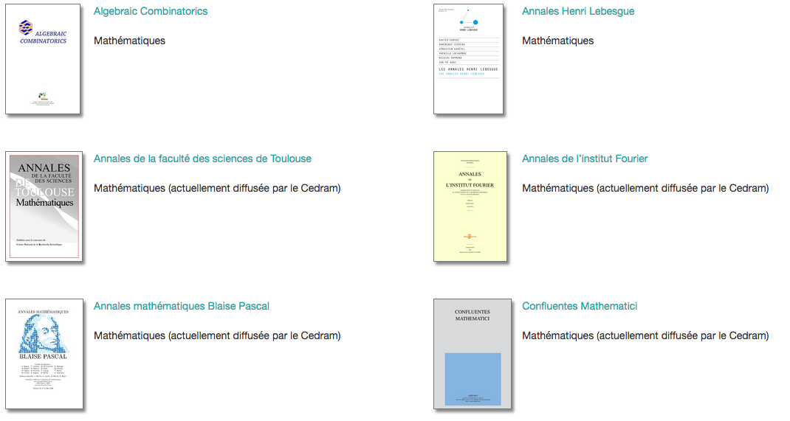
11 Journals published by ‘Mersenne’
Algebraic Combinatorics
Mathematics
Annales de la Faculté des Sciences de Toulouse
Mathematics
s
Annales Mathématiques
Blaise Pascal
Mathematics
Annales Henri Lebesgue
Mathematics
Annales de l’Institut Fourier
Mathematics
Confluentes Mathematici
Mathematics

Slide 14
11 revues publiées par le Centre Mersenne
Journal de l’Ecole Polytechnique
Mathematics
MathS in Action
Applied mathematics
SMAI Journal of
Computational Mathematics
Applied mathematics
Journal de Théorie des nombres
de Bordeaux
Mathematics
Publications Mathématiques de Besançon
Mathematics

Slide 15
Today Green Open Access is the best
Today, publishers own journals, together with bibliometry data,
that they use as marketing tools to control market,
and impose Gold OA to keep control of prices (e.g., APCs),
which leads to the creation of predatory journals.
Today, researchers want to preserve journals useful to them
(those having good reputation and excellent practices),
therefore they submit their articles to those they prefer,
and deposit their « author’s version » in a public open repository.
Green OA is the best solution for a smooth transition to OA,
since it preserves academic freedom and prepares Diamond OA.
http://openscience.ens.fr/MARIE_FARGE

Slide 16
Dissemin, a platform to boost Green OA
In September 2014 Antonin Delpeuch created http://dissem.in
(he was then student in computer sciences at ENS Paris),
which is collectively developed in open source.
‘Spot your own paywalled papers.
Liberate them in one click!’

Slide 17
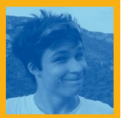
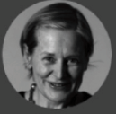
The team CAPSH / Dissemin
http://dissem.in is supported by the non profit association CAPSH
(Committee for the Accessibility of Publications in Sciences and Humanities)
created on September 5th 2015 by :
Creator and main developer
of the platform Dissemin
2016
Antoine Amarilli
Pablo Rauzy
Marie Farge
Thomas Bourgeat

Slide 18
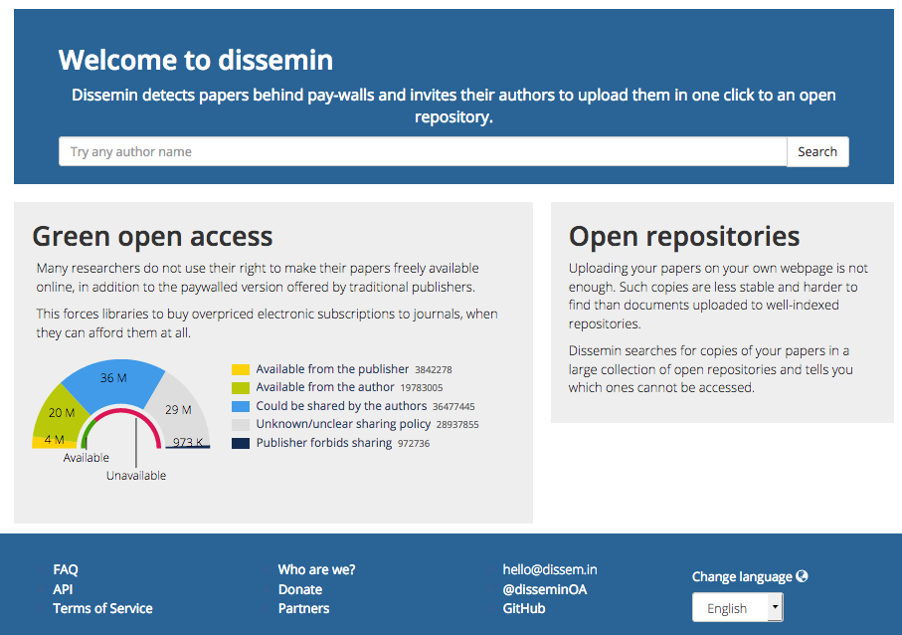
Dissemin lists the articles of any researcher
Dissem.in crawls among
about 100 millions d’articles

Slide 19
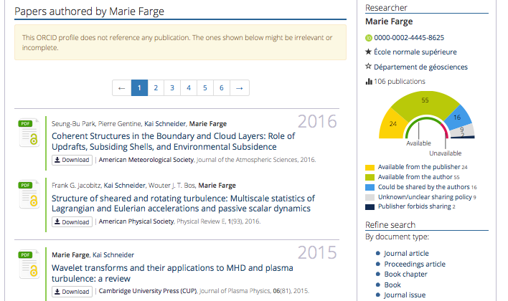
Example
Papers already
in open access can
be downloaded :

Slide 20
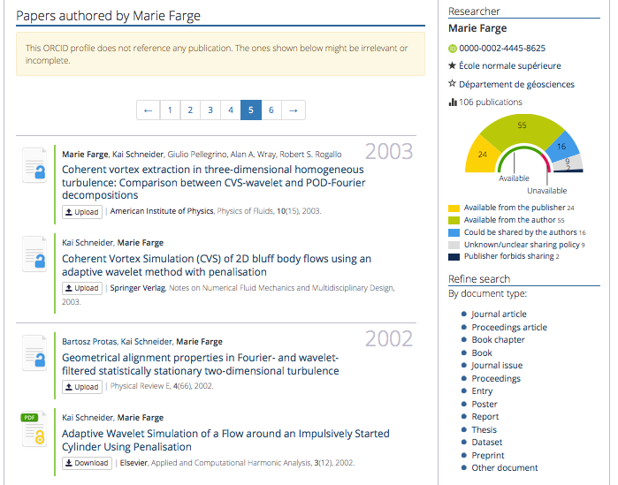
Papers not yet
in open access can
be deposited :

Slide 21
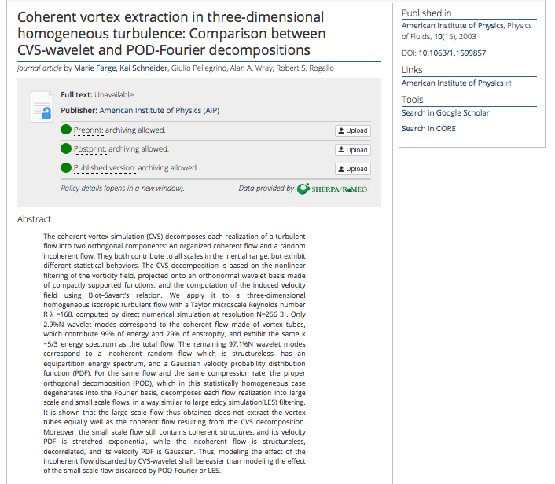
For each article
Dissem.in checks
which version
the publisher
allows to deposit
in open access
and
provides
a very simple way
to deposit it in an
open repository
(e.g., Zenodo, HAL).

Slide 22
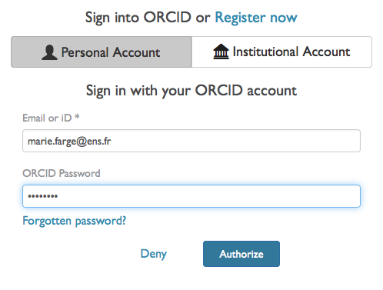
To deposit an article via Dissemin
Authors should register and identify themselves to be able to deposit their article.

Slide 23
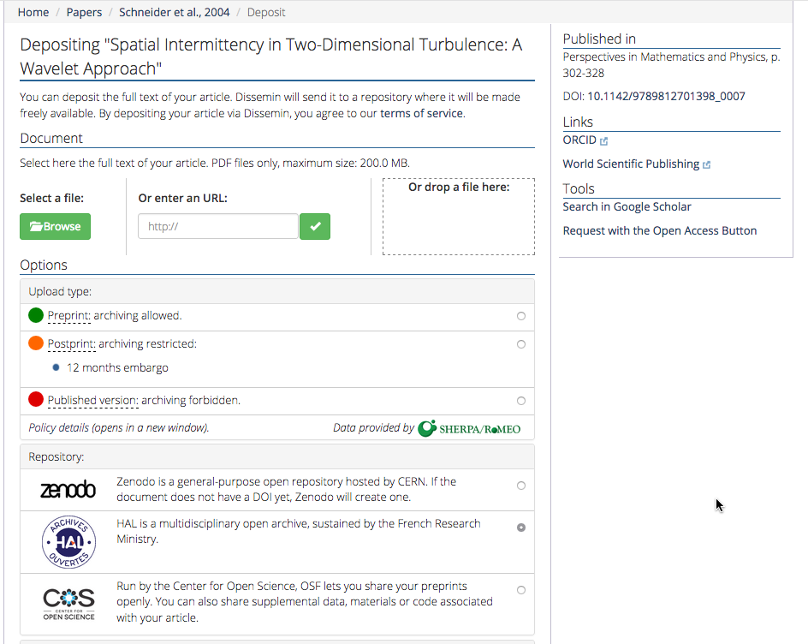
First click to choose
the version to deposit
Second click
to choose the
plateform where
to deposit

Slide 24
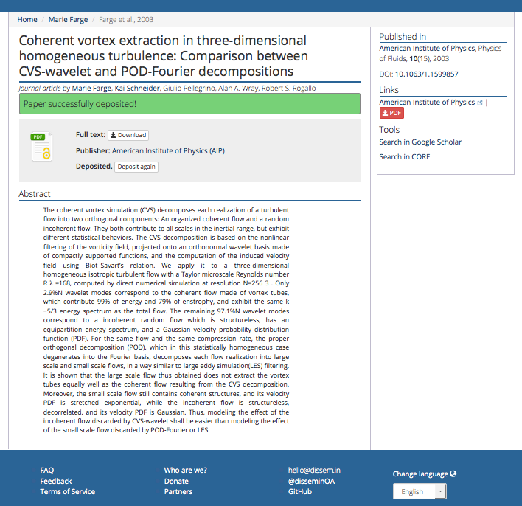
Anyone can now download
your article for free
from Zenodo,
the open repository of
CERN that is funded by
the European Commission
as part of the network
OpenAIRE.

Slide 25
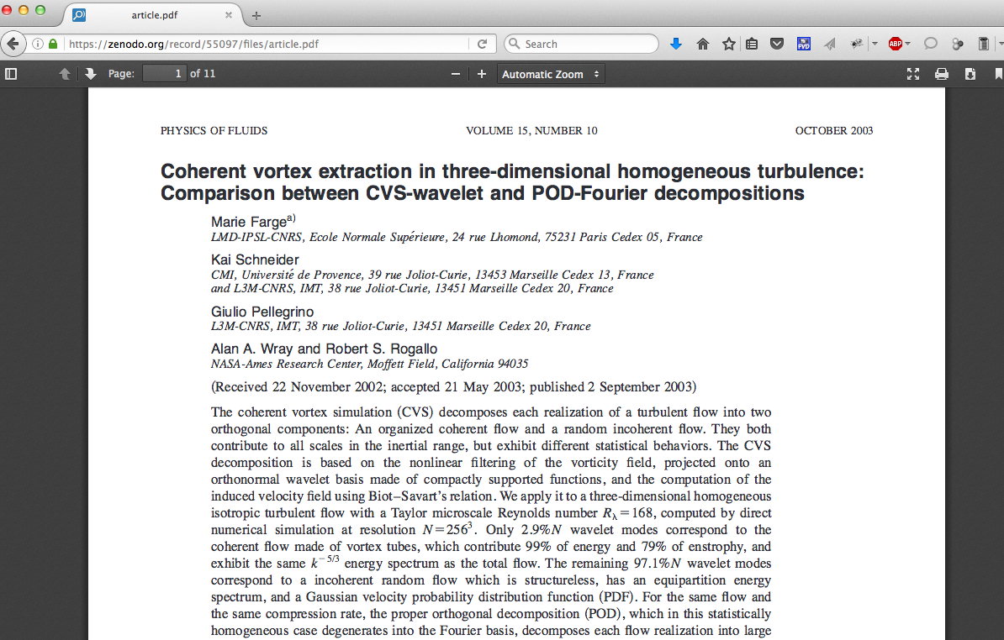
The article is now in open access

Slide 26
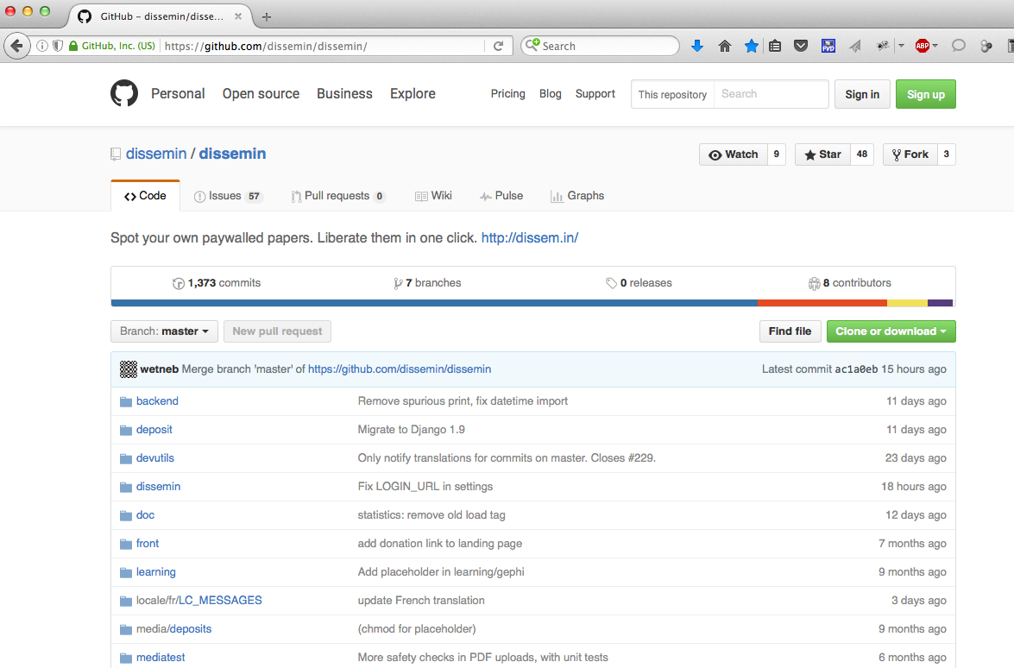
The source of Dissemin is free on GitHub

Slide 27
To follow the development of Dissemin
Antonin
Ryan
The source is written in Python, html, CSS and JavaScript.
You are most welcome to participate to its development !

Slide 28
Conclusion
Today investments, for producing and peer-reviewing articles,
are public but ownership of journals, peer-reviewing reports,
platforms (for peer-reviewing, publishing, bibliometry)
and profits (from subscriptions, APCs and data) are private.
Publishers should become service providers to
publicly funded and publicly owned publishing platforms,
without owning anymore articles, journals, platforms
(for peer-reviewing, publishing, bibliometry) and data.
Funding agencies should provide
public platforms developed in open source
for peer-reviewing, publishing and archiving research outputs.
Intellectual property laws should guarantee that research outputs
remain public and open to develop knowlegde as a commons.

Slide 29
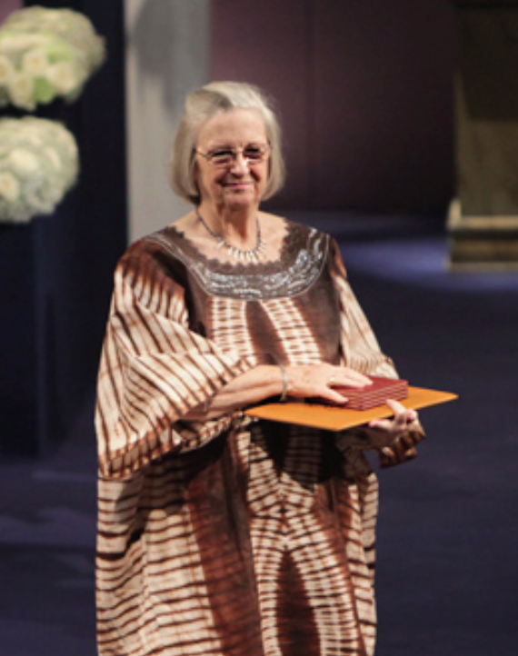
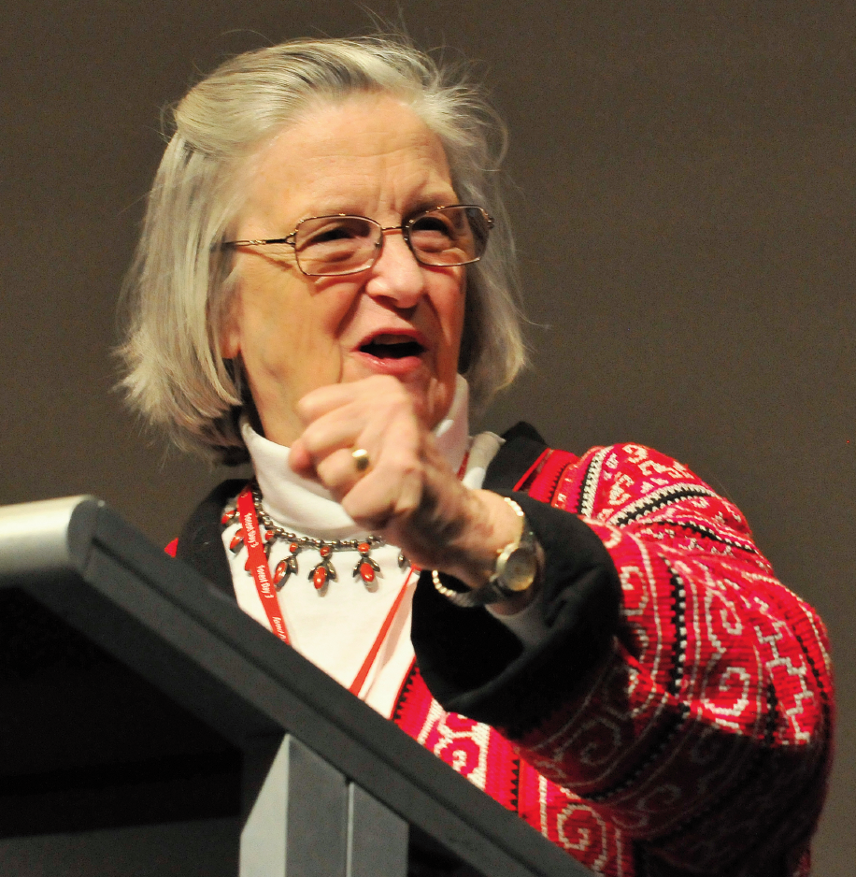
Elinor Ostrom (1933-2012)
Charlotte Hess and Elinor Ostrom,
Understanding knowledge as a Commons,
MIT Press, 2006
The only woman who has ever received the Nobel prize in economic sciences.

Slide 30
Principle
Ideas are not of the same nature as material products,
since when you give an idea you do not lose it.
Therefore, knowledge is not a product to be traded,
but a commons to be shared,
since exchange of ideas is a positive-sum game.
In 2009 Elinor Ostrom got the
Nobel prize in economic sciences for
‘her analysis of economic gouvernance,
especially the commons, showing how
common resources can be managed successfully
by the people who use them, rather than
by governments or private companies’.

Slide 31
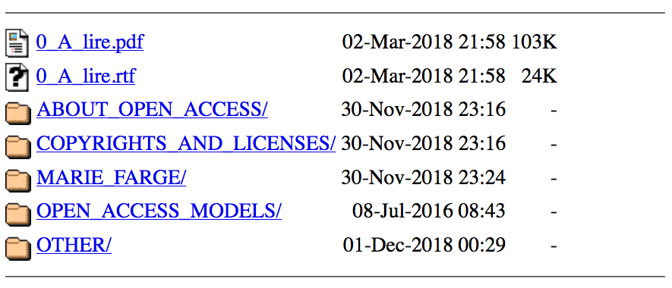
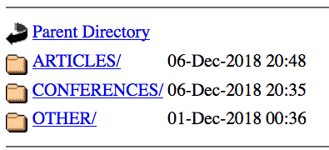
http://openscience.ens.fr
http://openscience.ens.fr/MARIE_FARGE
marie.farge@ens.fr
http://wavelets.ens.fr

