Slide 1
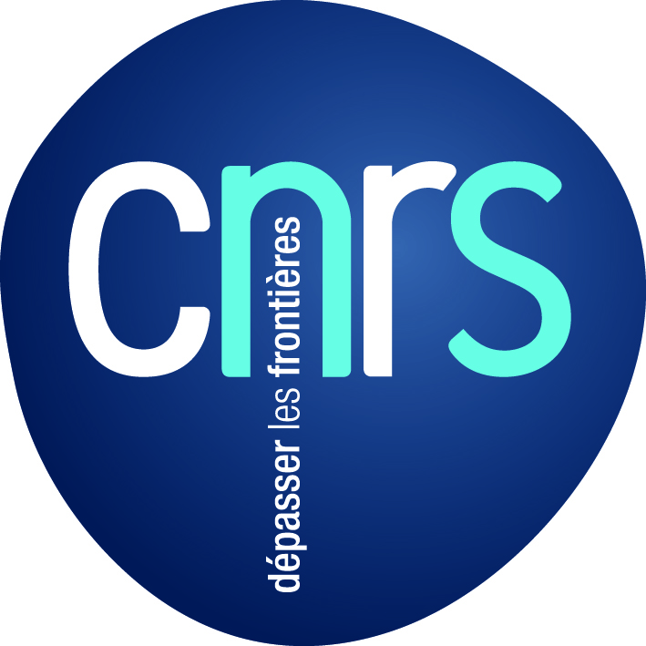
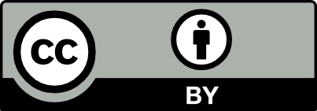
Publishing and peer-reviewing
in open access
Marie Farge
CNRS (Centre National à la Recherche Scientifique)
and ENS (Ecole Normale Supérieure) Paris
April 27th 2018
Research and Innovation Center, OpenAIRE,
Athens

Slide 2
Principle
Ideas are not of the same nature as material products,
since when you give an idea you do not lose it.
Therefore, knowledge is not a product to be traded,
but a commons to be shared,
for exchange of ideas is a positive-sum game.
Charlotte Hess and Elinor Ostrom,
Understanding knowledge as a Commons,
MIT Press, 2006
In 2009 Elinor Ostrom got the Nobel prize in economic sciences
for ‘her analysis of economic gouvernance,
especially the commons, showing how
common resources can be managed successfully
by the people who use them, rather than
by governments or private companies’.

Slide 3
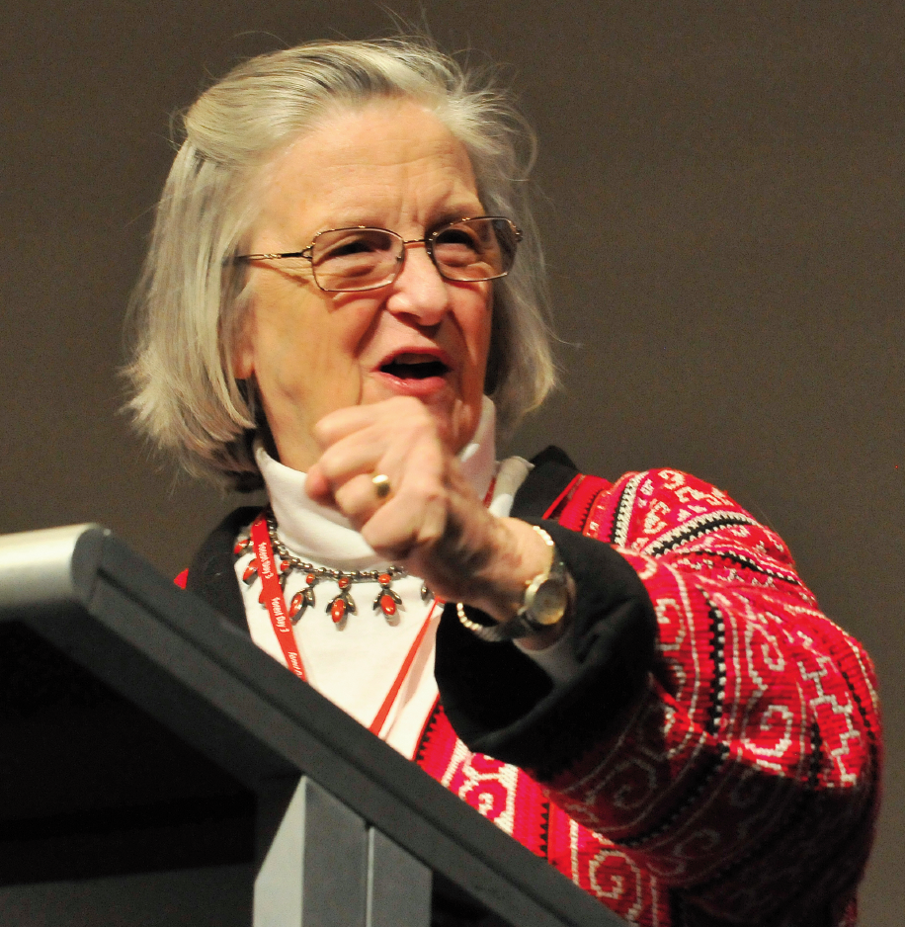
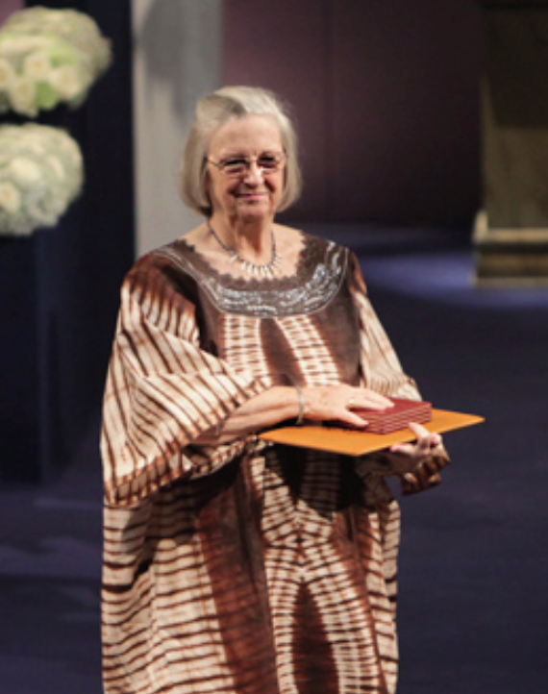
Elinor Ostrom (1933-2012)
She was professor of political science
at Indiana University (USA)
and the only woman
who has ever received the
Nobel prize in economic sciences.

Slide 4
What publishing is for?
Research is a collaborative endeavour, in both space and time,
that advances through discussions, seminars, conferences
and the publication of peer-reviewed articles.
Publishing means making the research outputs publicly available.
Peer reviewing means checking the content of articles by peers
(to find errors, assess results’ originality and improve presentation).
Peers are researchers in activity (not employees of publishers).
Peer-reviewing and publishing guarantee
validation, reproduction, transmission and conservation
of research outputs for the advancement of knowledge.

Slide 5
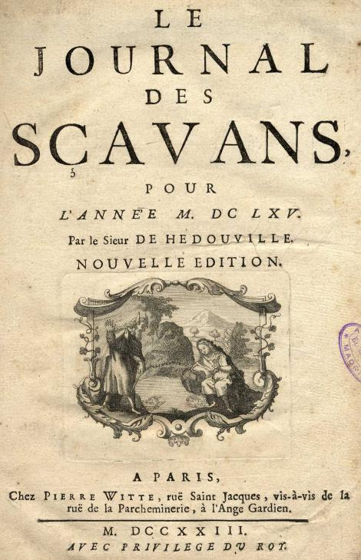
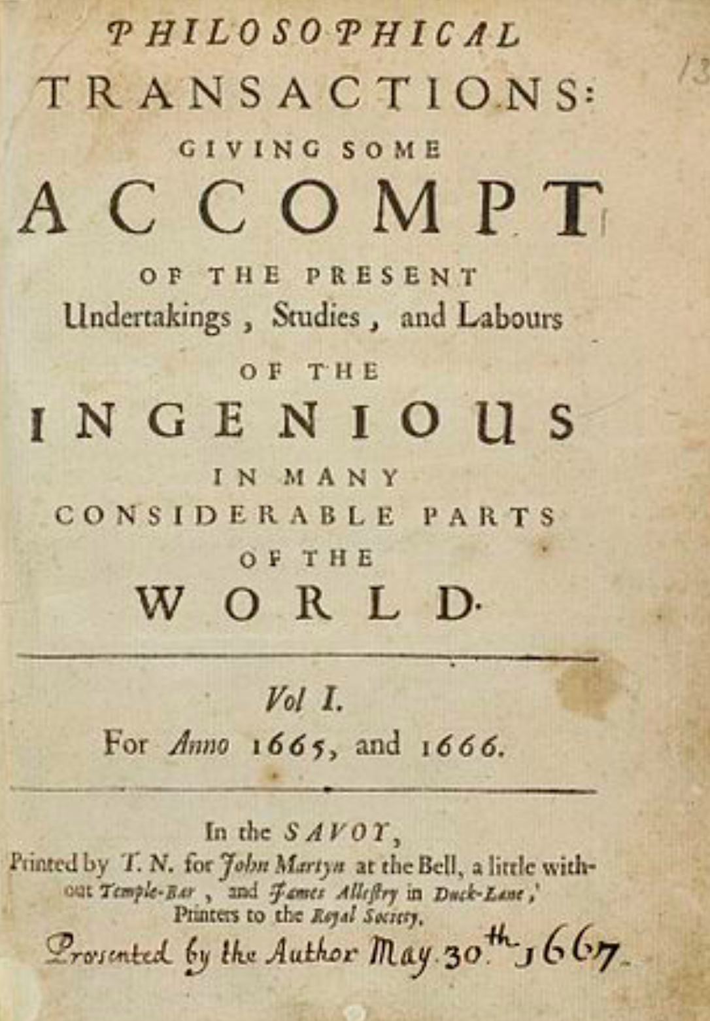
Peer-reviewed scholarly journals
The publication of research outputs in peer-reviewed journals
is the backbone of the present research system.
It was founded on January 5th 1665 for sharing ideas and results.
It is also used today for evaluating researchers and projects.
Paris, 5th January 1665
London, 6th March 1665

Slide 6
How are we peer-reviewing and publishing today?

Slide 7
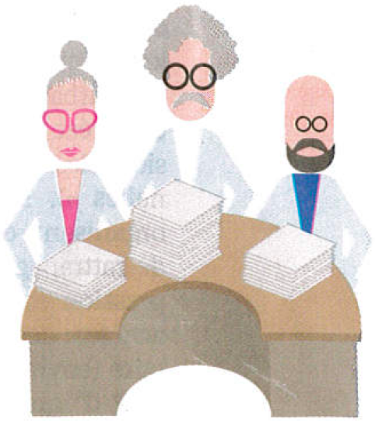
Business model of peer-reviewed journals
Taxpayers
Researchers write articles,
typeset them in final format,
review those of their peers,
are editors of scholarly journals.
Researchers
acting as editors
After papers are accepted
by reviewers and editors,
publishers put them online,
insure their visibility,
occasionally print them,
and sell them.
Their salaries
are paid
by taxpayers
Publishers
Librarians negociate subscription contracts,
pay them, control access to the journals
and curate collections of articles.

Slide 8
Publishers own articles, journals and more…
Before publishing the accepted papers,
publishers require that researchers
transfer them their copyrights for free!
Publishers own intellectual property of
the text, figures and data contained in articles
for more than 100 years. They can thus
sell articles at the prices and conditions
they set, with non-disclosable contracts.
Publishers also own the scholarly journals,
plus all derivatives (e.g., databases), plus the
peer-reviewing and publishing plaftforms,
and the bibliometric data used to evaluate
research projects and researchers’ career.
Profit margin
up to 40% !

Slide 9
Authors must give their copyrights for free !

Slide 10
Example of the copyright transfer form we signed on
January 24th 2017 to publish an article online in Journal of Turbulence

Slide 11
Our paper was published online on February 6th 2017 and
we then have to pay the publisher Taylor&Francis to read it
We, the authors, and anyone else,
have to pay 82 € to the publisher
to buy the right to read our article
online during 30 days only !

Slide 12
Who has access to peer-reviewed articles ?
Only researchers working in institutions and countries rich enough
to afford the very costly subscriptions to scholarly journals.
Researchers working for companies or in poor institutions,
teachers, students, retired researchers and all citizens who finance
public research do not have access to most of the scholarly articles.
By 2000 most of the renown scholarly journals have been bought
by few major publishers, whose exceptional profits rely on the work
that researchers and their funding agencies offer them for free.
Publishers benefit from the digital revolution and the Web to
to reduce production costs using online peer-reviewing and publishing,
but keep the business model designed for printing on paper.
Today few major publishers have acquired an oligopolistic position.

Slide 13
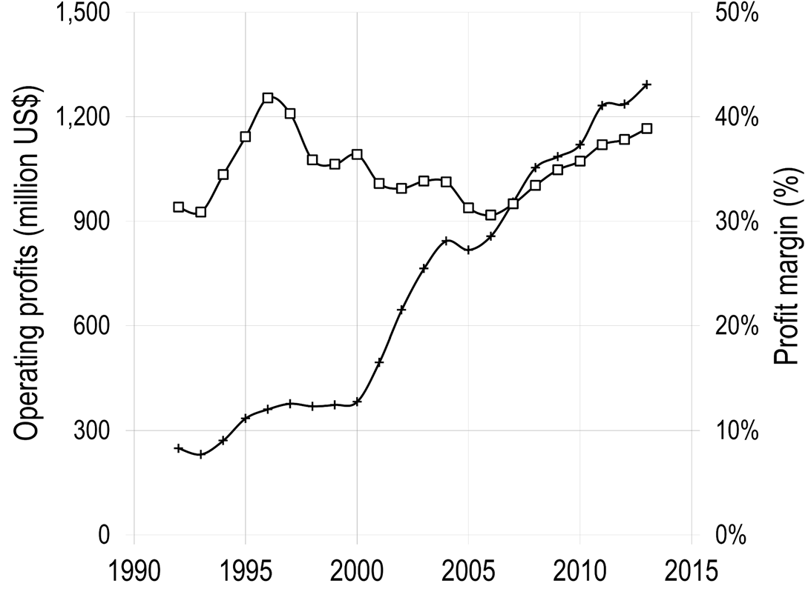
Operating profits and profit margin of the publisher Reed-Elsevier
for its Scientific, Technical and Medical (STM) division from 1990 to 2015
Operating profits
Profit margin
1.2 billion US$
Vincent Larivière et al., The Oligopoly of Academic Publishers, PLOS one, 10th June 2015

Slide 14
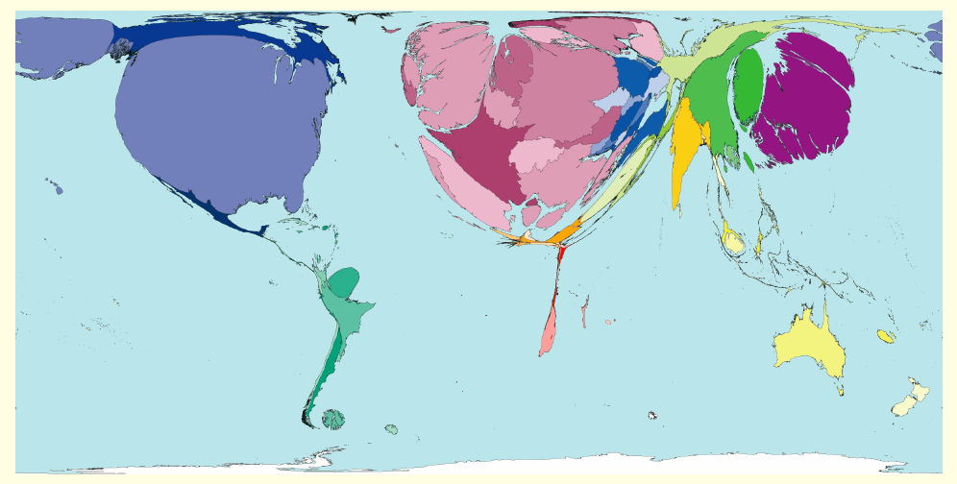
Density of peer-reviewed articles per country
Number of articles
divided by the
number of inhabitants
Today, publishers want to impose
the Gold Open Access model,
which flips subscription costs into
Article Processing Charges (APCs)
that researchers pay them to publish
Gold OA is counter-productive since
researchers would no more publish
or their institutions get bankrupted!
http://www.worldmapper.org
http://www.scimagoir.com

Slide 15
Which publishing system might benefit to researchers rather than to publishers?

Slide 16
What do we need publishers for ?
‘Since the creation of scientific journals 350 years ago, large commercial publishing houses have increased their control of the science system. While one could argue that their role of typesetting, printing, and diffusion were central in the print world, the ease with which these functions can be fulfilled in the electronic world makes one wonder: what do we need publishers for? […] It is up to the scientific community to change the system in a similar fashion and in parallel to the open access and open science movements. Unfortunately, researchers are still dependent on one essentially symbolic function of publishers, which is to allocate academic capital, thereby explaining why the scientific community is so dependent on The Most Profitable Obsolete Technology in History ’
Vincent Larivière et al., The Oligopoly of Academic Publishers, PLOS one, 10th June 2015

Slide 17
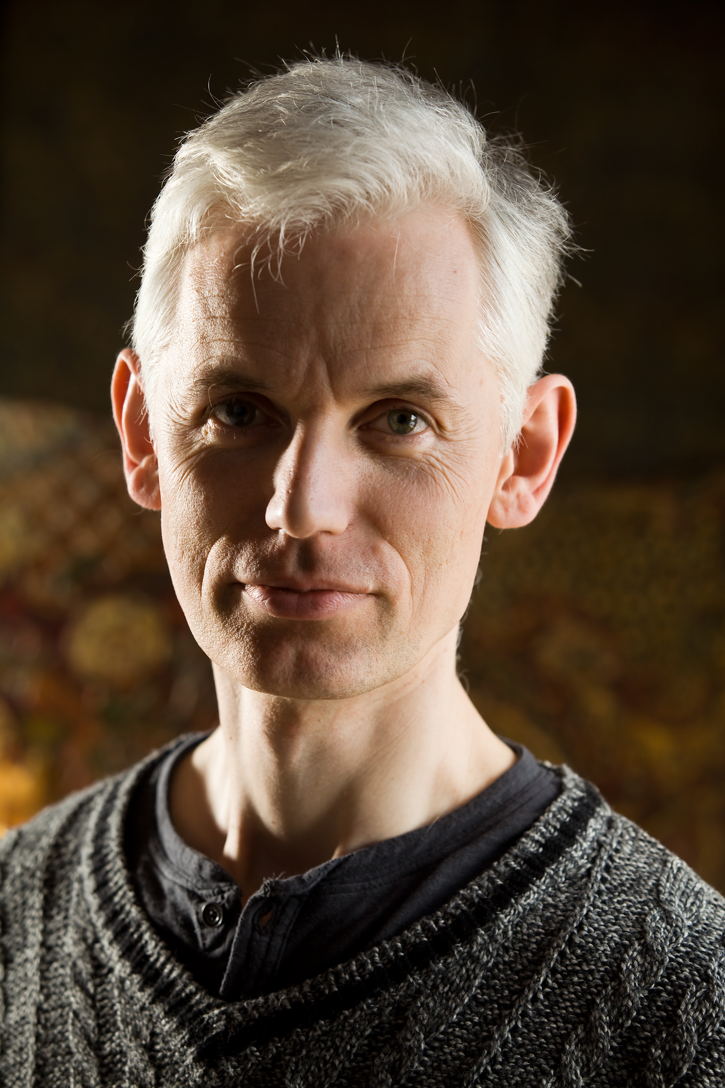
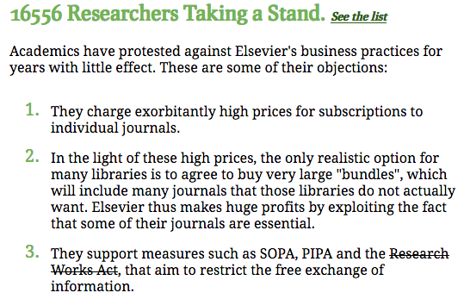
The Cost of Knowledge, 2012
Tim Gowers and 33 mathematician colleagues called to
boycott Elsevier and thus stopped the Research Works Act,
a bill to the US Congress Elsevier was lobbying for.
Sir Tim Gowers,
Cambridge University,
Fields medal 1998
http://www.thecostofknowledge.com/

Slide 18
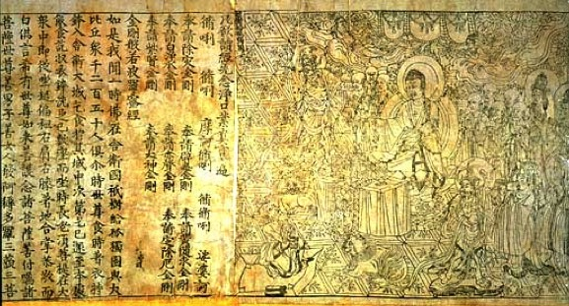
Researchers want to recover control
`Neither author nor reader should have to pay to publish and
a journal should not belong to its publisher but to its editorial board.
The publishing of peer-reviewed articles should be done using
public infrastructures from where articles are accessible online for free.’
Marie Farge, Note for the French Minister of Research, June 29th 2012
http://openscience.ens.fr/MARIE_FARGE/
CoK have proposed
the alternative model
Diamond Open Access
Diamond Sutra,
the earliest complete survival
of a dated printed book,
China, 11th May 868
British Library, London

Slide 19
Diamond Open Access
1
Authors keep their copyright and allow
their articles to be published in Open Access
(under the Creative Commons license CC-BY).
https://creativecommons.org/licenses/
2
Editors of a peer-reviewed journal collectively own its title and assets,
since they are in charge of peer-reviewing the submitted articles
(editors and referees do this for free, as part of their academic duty).
3
Publishers no more own the peer-reviewed journals
but provide services their editors
(that select them on a competitive basis).

Slide 20
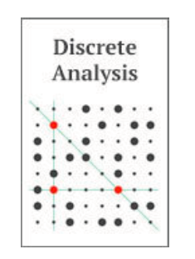
Examples of Diamond OA journals
1
//www.ipol.im ISSN : 2105-1232 DOI : 10.5201/ipol
Founded in 2010 by Jean-Michel Morel, IPOL has 41 editors.
It is financed by CNES, ERC and 13 public institutions from 5 countries.
Each article contains the text, the algorithm and the source code,
which all are peer reviewed. The journal platform also provides
online demonstration facility and an archive of experiments.
IPOL thus ensures open science and reproducible research.
2
http://discreteanalysisjournal.com ISSN : 2397-3129
Founded in 2015 by Tim Gowers, DA has 12 editors.
It is an overlay journal on the open repository arXiv.
It is financed by Cambridge University (10$/submission).

Slide 21
We need public publishing platforms
Funding agencies should provide, for free to researchers,
publicly-owned platforms, developed using open source software,
for peer-reviewing, publishing and archiving articles and data,
with the help of librarians and of publishers (as subcontractors).
Anyone from anywhere would have free (gratis and libre) access to peer-reviewed publications (e.g., articles, data, codes, videos)
without researchers having to pay to publish their results.
Funding agencies would thus control the quality of peer-reviewing,
by selecting the journals having good practices and reputable editors.
Such publishing platforms would give the chance to researchers
to experiment new ways of publishing (e.g., open peer-reviewing).

Slide 22
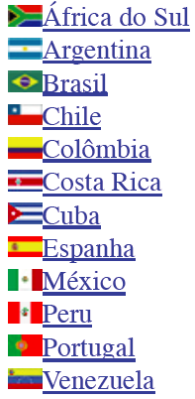
Examples of public publishing platforms
+
Created in 1999,
it publishes
1249 journals
in open access,
financed by public
agencies from Brazil
(FAPESP, CNPq,
BIREME) and from
15 other countries.
Created in 1999,
it publishes
451 journals
in open access,
financed by public
agencies from France
(CNRS, EHESS, BSN,
Aix-Marseille and
Avignon universities).
+

Slide 23
How to insure a smooth transition from printing on paper to online publishing?

Slide 24
Green Open Access
Today, publishers own journals, together with bibliometry data,
that they use as marketing tools to control market,
and impose Gold OA to keep control of prices (e.g., APCs),
which leads to the creation of predatory journals.
Today, researchers want to preserve journals useful to them
(those having good reputation and excellent practices),
therefore they submit their articles to those they prefer,
and deposit the « author’s version » in a public open repository.
Green OA is the wisest solution for a smooth transition to OA,
since it preserves academic freedom and prepare Diamond OA.
http://openscience.ens.fr/MARIE_FARGE

Slide 25
Dissemin, a platform to boost Green OA
In September 2014 Antonin Delpeuch created http://dissem.in
(he was then student in computer sciences at ENS Paris),
which is collectively developed in open source.
‘Spot your own paywalled papers.
Liberate them in one click!’

Slide 26
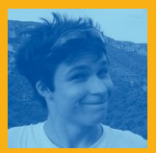
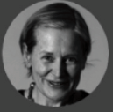
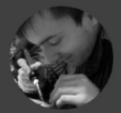
The team CAPSH / Dissemin
http://dissem.in is supported by the non profit association CAPSH
(Committee for the Accessibility of Publications in Sciences and Humanities)
created on September 5th 2015 by :
Creator and main developer
of the platform Dissemin
2016
Antoine Amarilli
Pablo Rauzy
Marie Farge
Thomas Bourgeat

Slide 27
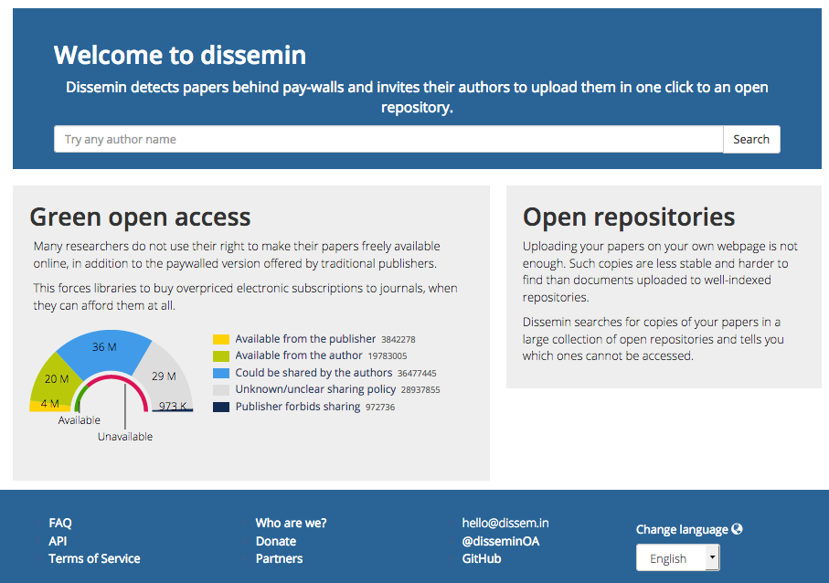
Dissemin lists the articles of any researcher
Dissem.in Crawle among
About 100 millions d’articles

Slide 28
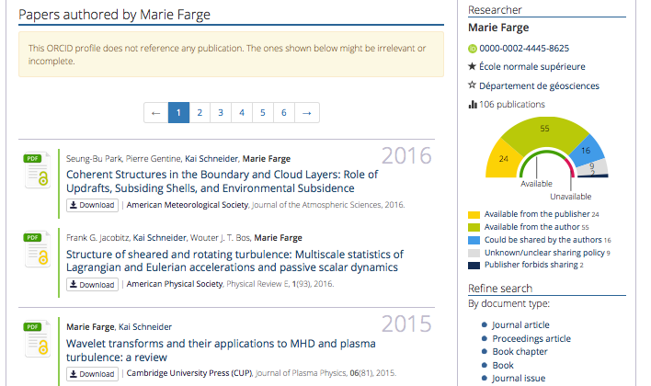
Example
Papers already
in open access can
be downloaded :

Slide 29
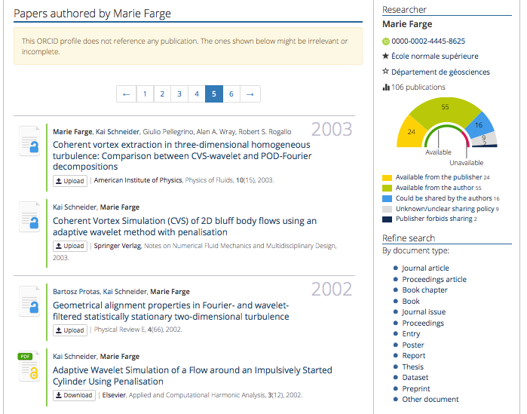
Papers not yet
in open access can
be deposited :

Slide 30
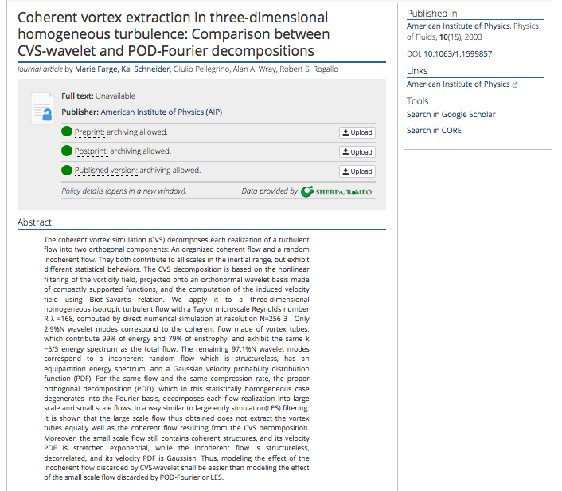
For each article
Dissemin checks
if the publisher
allows to deposit
the paper, and
which version.

Slide 31
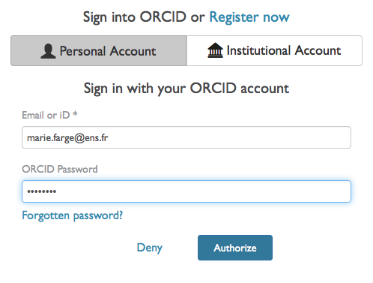
To deposit an article via Dissemin
Authors should register and identify themselves to be able to deposit their article.

Slide 32
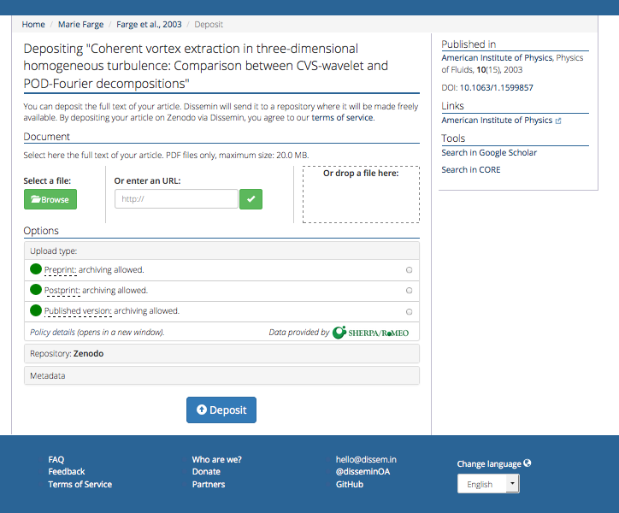
First click
to choose
the version
to deposit

Slide 33
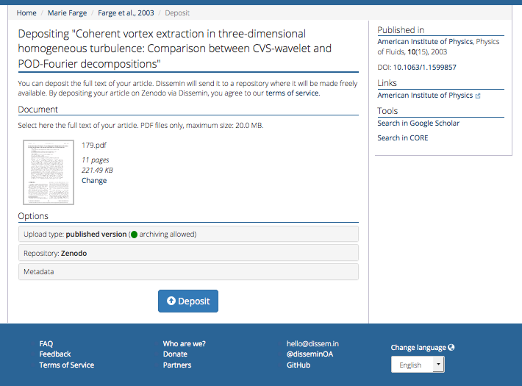
Second click
to deposit
in Zenodo

Slide 34
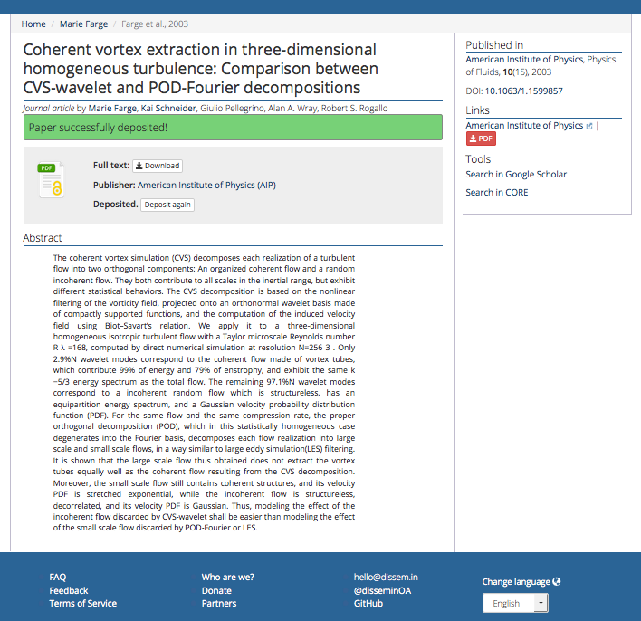
Anyone can now download
your article for free
from Zenodo,
the open repository of
CERN that is funded by
the European Commission
as part of the network
OpenAIRE.

Slide 35
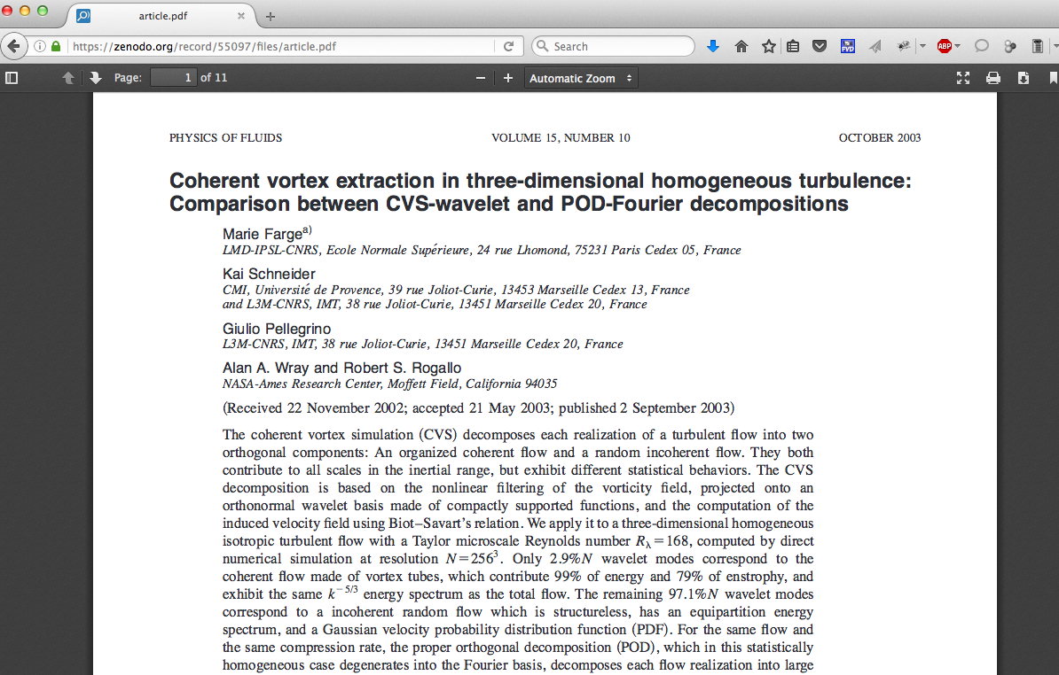
The article is now in open access

Slide 36
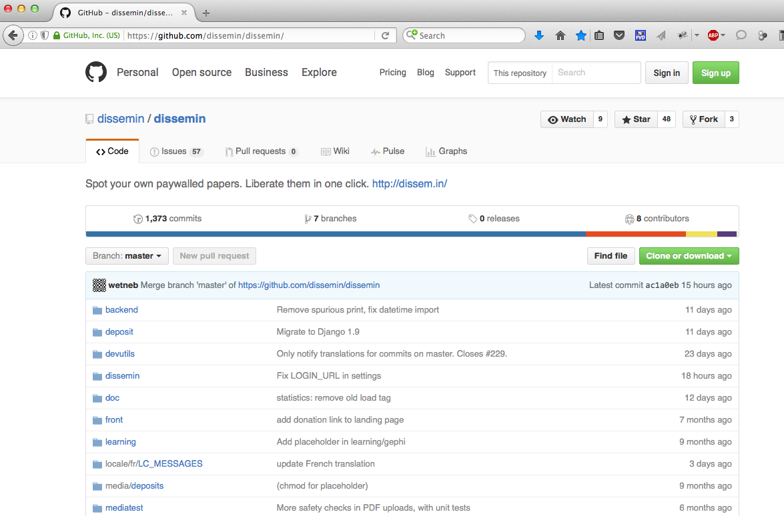
The source of Dissemin is free on GitHub

Slide 37
To follow the development of Dissemin
Antonin
Ryan
You are also welcome to participate to its development in Python !

Slide 38
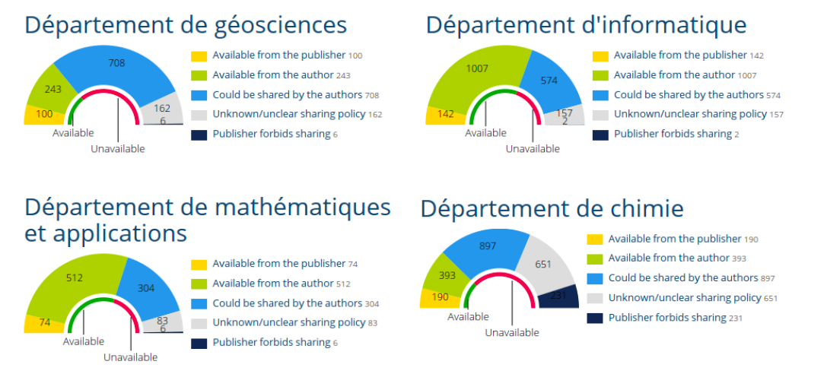
To list the articles from an institution
With Dissemin you can generate the list of the scholarly articles
published by the researchers of an institution and get some statistics.
Here is the example of Ecole Normale Supérieure Paris :
http://dissem.in/institution/1/

Slide 39
http://dissem.in/institution/1/

Slide 40
Conclusion
Today investments, for producing and peer-reviewing articles,
are public but ownership of journals, peer-reviewing reports,
platforms (for peer-reviewing, publishing, bibliometry)
and profits (from subscriptions, APCs and data) are private.
Publishers should become service providers to
publicly funded and publicly owned publishing platforms,
without owning anymore articles, journals, platforms
(for peer-reviewing, publishing, bibliometry) and data.
Funding agencies should provide public platforms to researchers
for peer-reviewing, publishing and archiving research outputs.
Intellectual property laws (copyright/copyleft) should be improved to
guarantee that research outputs remain public and open.
We need those tools to develop knowlegde as a commons.

Slide 41
'Scholarly publishing and peer-reviewing in open access’, Marie Farge, 2017
in 'Europe’s Future: Open Science, Open Innovation, and Open to the World’, European Commission, DG Research, Science and Innovation, April 2017
http://openscience.ens.fr/MARIE_FARGE
http://wavelets.ens.fr
http://dissem.in
http://new.dissem.in
http://association.dissem.in
https://github.com/dissemin
@disseminOA
Antonin Delpeuch <antonin@delpeuch.eu>
Marie Farge <marie.farge@ens.fr>
Team Dissemin <team@dissem.in>

