Slide 1
Open Access in a European policy context
Daniel Spichtinger
Senior Policy Officer, European Commission DG RTD, Unit A.6.
Daniel.spichtinger@ec.europa.eu
OPEN SCIENCE AS A COMMON GOOD, May 3, 2017

Slide 2
Agenda
Open Access - The general concept
National and international policies
Open access to scientific peer reviewed publications in Horizon 2020

Slide 3
Open Access (OA)
OA = online access at no charge to the user
to peer-reviewed scientific publications
to research data (→ data management implications)
Part of open science, systemic change in the modus operandi of science and research affecting the whole research cycle and its stakeholders
Two main OA publishing business models (for publications)
Self-archiving: deposit of manuscripts & immediate/delayed OA provided by author ("Green OA")
OA publishing: immediate OA provided by publisher ("Gold OA"), e.g. 'author-pay' model (APC)

Slide 4
open access loop - green
Research is done
Researchers write
article
Submitted to Journal
Peer review
Access is maximized
Author’s manuscript is self-archived in Repository, sometimes with an embargo period
Revision by article’s Authors
Article Accepted, Certified, Published by Journal
Researchers can only access the article if their university has a subscription to the Journal (during embargo period)
New research builds on published results

Slide 5
open access loop - gold
Research is done
Researchers write
article
Submitted to Journal
Peer review
Revision by article’s Authors
Article Accepted, Certified, Published by Journal
Article becomes available open access on the journal website, often institution/funder pays article processing charges (APCs)
Access is maximized
New research builds on published results
New research builds on published results

Slide 6
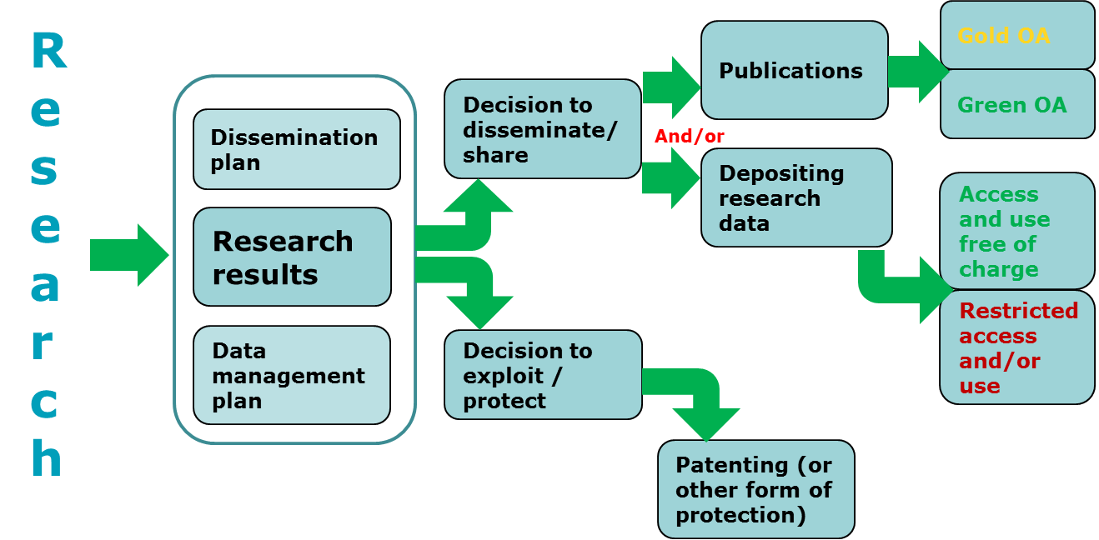
What OA is NOT
Not an obligation to publish
Not at odds with patenting (see graph)
OA publications go the same peer review process

Slide 7
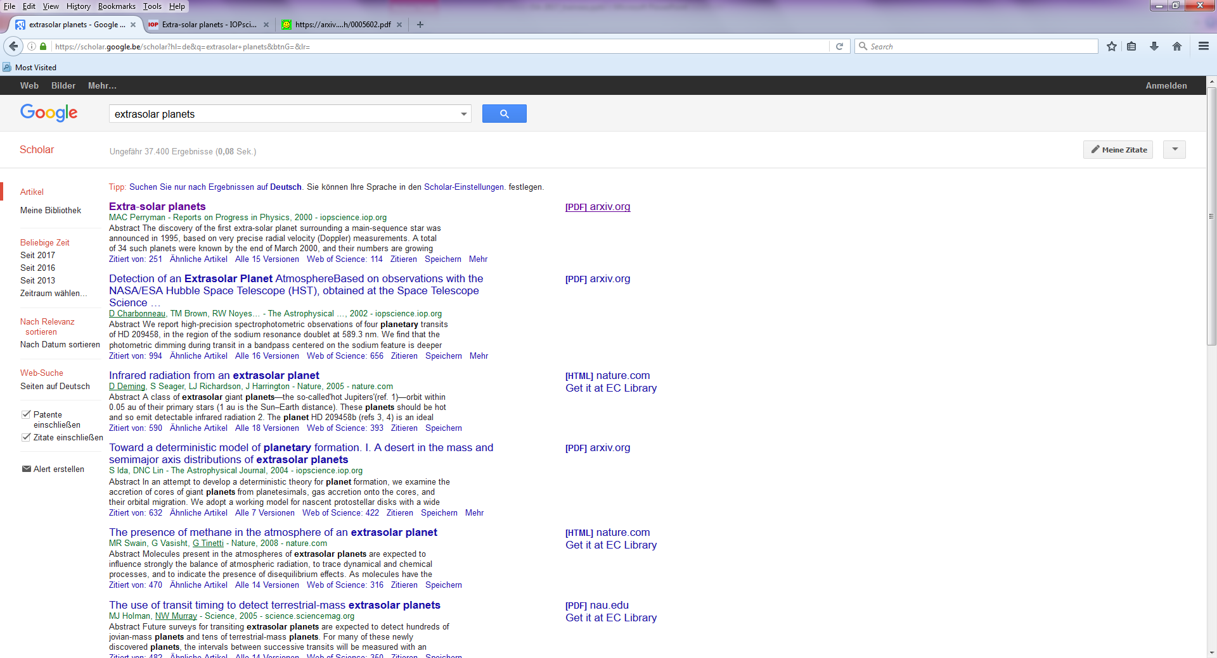
Looking for scientific information in the 21st century

Slide 8
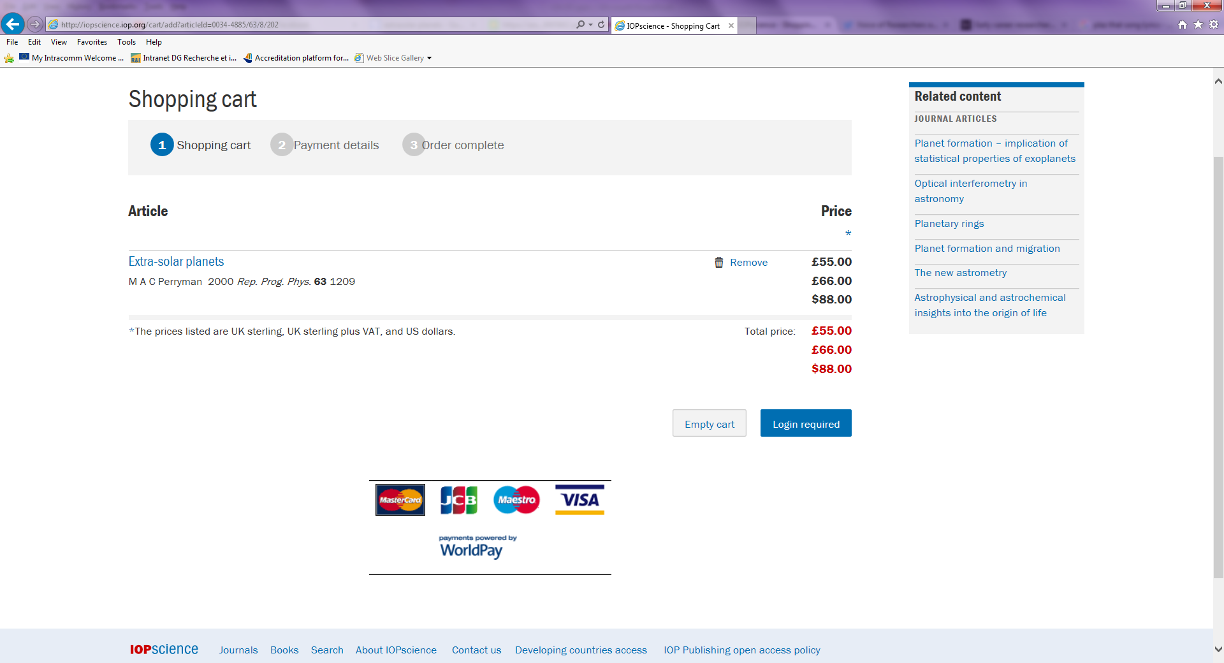
The paywall

Slide 9
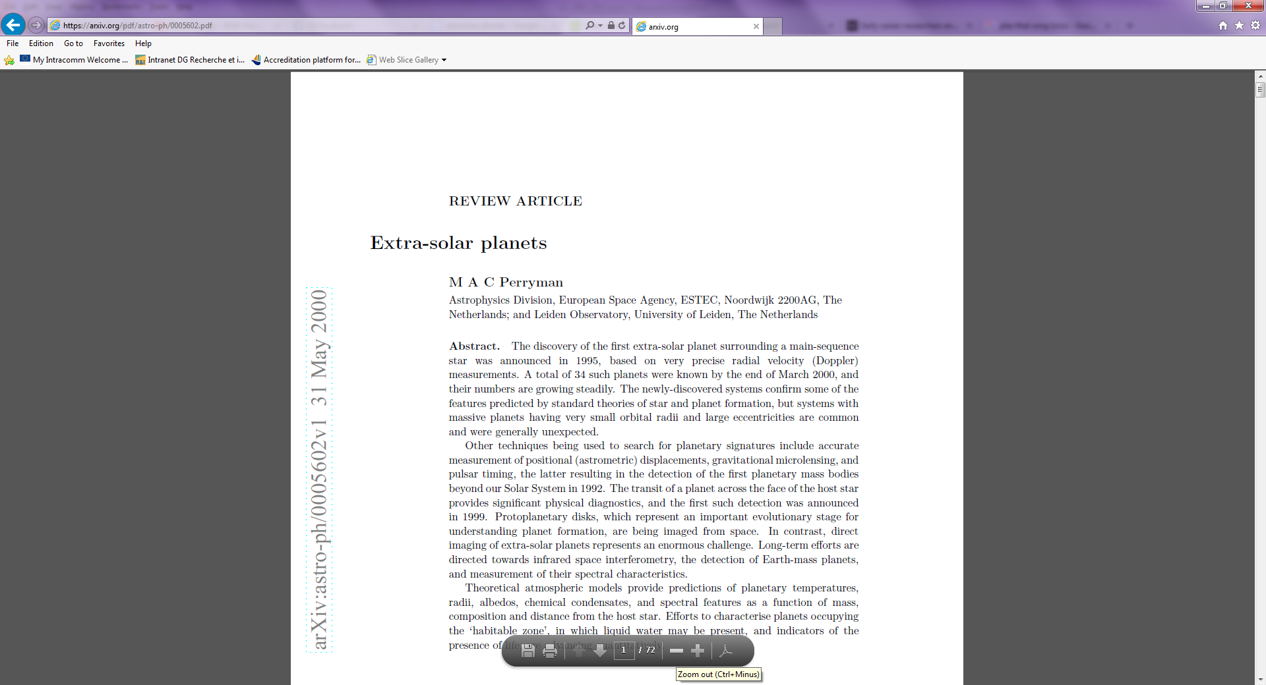
arxiv

Slide 10
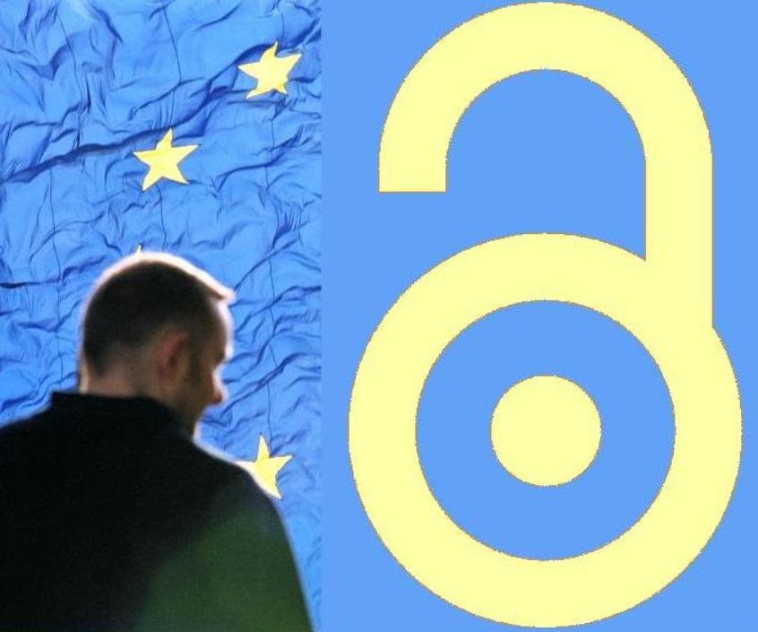
The EU & open access

Slide 11
The Commission objective
optimise the impact of publicly-funded scientific research
At European level (Horizon 2020)
At Member State level (ERA)
One way to get there: open access
Expected benefits:
Better and more efficient science
Economic growth
Broader, faster, more transparent and equal access for the benefit of researchers, industry and citizens
… in the European Research Area and beyond

Slide 12
The European Commission is a...
Policy maker
It proposes EU legislation & legislates with other EU institutions
It invites Member States to act
Funding agency
It sets its own access and dissemination rules for EC-funded research
Capacity builder
It funds projects that support EC/EU policy

Slide 13
Three key documents (16.07.2012)
Communication 'A reinforced European Research Area partnership for excellence and growth'
Communication 'Towards better access to scientific information: boosting the benefits of public investments in research'
Recommendation on access to and preservation of scientific information

Slide 14
Political Support Council Conclusions 27 May 2016
WELCOMES OA to scientific publications as the default. Target of 100% OA by 2020
SUPPORTs optimal re-use of data with the underlying principle of "as open as possible as closed as necessary"
WELCOMES the intention of the Commission to make research data produced by Horizon 2020 open by default, whilst recognising the right of opting out
CALLS on the Commission to promote data stewardship, including DMPs – importance of making data findable, accessible, interoperable and re-usable (FAIR)

Slide 15
Open access policies across the EU
most EU Member States reported a national preference for one of the two types of open access,
Preference for the Green model: Belgium, Cyprus, Denmark, Estonia, Greece, Ireland, Lithuania, Malta, Norway, Portugal, Slovakia and Spain.
Preference for the Gold model: Hungary, the Netherlands, Romania, Sweden and the United Kingdom.
Other Member States support both models equally, such as Germany, France, Croatia, Italy, Luxembourg, Poland and Finland.
However, there is generally a system of predominance of one model with the possibility of using the other model, so a mixture of both routes results.
In most cases based on soft-law, not national legislation

Slide 16
The international landscape
Robust open access policies around the world – not invented in Europe
Strong US OA mandate for federally funded research (agencies with budget of over 100 million €), most notably NIH
Strong green open access mandate in Latin America (SCIELO)
Strong open access policies also in Canada, Australia and Japan
Developing policies in other countries, e.g. China, Russia…
Key non-state funders also have robust mandates (Wellcome Trust, Gates Foundation)

Slide 17
Open access in Horizon 2020

Slide 18
Open access in Horizon 2020
Regulation establishing Horizon 2020
"To increase the circulation and exploitation of knowledge, open access to scientific publications should be ensured. Furthermore, open access to research data resulting from publicly funded research under Horizon 2020 should be promoted, taking into account constraints pertaining to privacy, national security and intellectual property rights"
Open access to scientific publications resulting from publicly funded research under Horizon 2020 shall be ensured [...].
Open access to research data resulting from publicly funded research under Horizon 2020 shall be promoted. [...].

Slide 19
From FP7 to H2020: OA to publications from pilot to underlying principle
Obligation to provide OA, either through the Green or Gold way in all areas (deposition mandatory either way)
Allowed embargoes: 6/12m
Gold open access costs eligible for reimbursement as part of the project budget while the project runs & post-grant support being piloted through OpenAIRE
Authors encouraged to retain copyright and grant licences instead

Slide 20
OA to publications in H2020: first results
87% of Horizon 2020 projects have not yet produced publications
1639 projects have already produced a total number of 7376 publications,
61-68% of scientific publications produced as a result of Horizon 2020 funding are already open access
Most of them green open access with an average embargo period of 11 months
An encouraging start but more needs to be done

Slide 21
Open Science Policy Platform
European Commission
European Open Science Agenda:
OA publishing models
FAIR open data
Science Cloud
Alternate metrics
Rewards & careers
Education & skills
Citizen Science
Research integrity
…
ERA & framework conditions for actors:
European Charter for researchers
Code of conduct for Research Integrity
Charter for Access to Research Infra
…
Open Science
Policy Platform
DSM & framework conditions for data:
Copyright - TDM
Data Protection
Free Flow of Data
…
Wide input from stakeholders:
ad-hoc meetings and workshops
e-platform with wider community
reports and independent experts
EG on open science cloud
EG on altmetrics
EG on alt. business models for OA publishing
EG on FAIR open data
advice
context
opinions

Slide 22
In summary…
Open access as part of a changing scientific system (Open Science)
Open access as a means to improve knowledge circulation and provide value for the taxpayers' money
Horizon 2020 ambitious yet pragmatic on aspects of open access
Open access to publications mandatory but allows free choice of green or gold
Support from/for H2020: work programmes e-Infrastructure & Science with and for Society (e.g. OpenAIRE project)
Open access must be effective, affordable, competitive and sustainable for researchers and innovative businesses

Slide 23
Ressources
Open innovation, open science, open to the world. A vision for Europe
http://bookshop.europa.eu/en/open-innovation-open-science-open-to-the-world-pbKI0416263/
NPR report (Open Access in the EU Member States)
https://ec.europa.eu/research/openscience/pdf/openaccess/npr_report.pdf#view=fit&pagemode=none
H2020 guidance
http://ec.europa.eu/research/participants/docs/h2020-funding-guide/cross-cutting-issues/open-access-dissemination_en.htm
May 2016 Council Conclusions
http://data.consilium.europa.eu/doc/document/ST-9526-2016-INIT/en/pdf
Uptake of open access to scientific publication in Horizon 2020:
https://data.europa.eu/euodp/data/dataset/open-access-to-scientific-publications-horizon2020

Slide 24
We welcome your input
Contact us
Mail: RTD-open-access@ec.europa.eu
Web: http://ec.europa.eu/research/openscience/index.cfm
Twitter: @OpenAccessEC

