Slide 1
Knowledge as a commons:
How to improve the peer review
and dissemination of research outputs
Marie Farge
CNRS (Centre National à la Recherche Scientifique)
and ENS (Ecole Normale Supérieure) Paris
March 2nd 2017
Barcelona Knowledge Hub
of the Academia Europaea

Slide 2
Knowledge as a commons
Ideas are not of the same nature as material products
since when you give an idea, you do not lose it.
Therefore knowledge is not a product to be traded,
but a commons to be shared since
its exchange is a positive-sum game.
Charlotte Hess and Elinor Ostrom,
Understanding knowledge as a Commons,
MIT Press, 2006
Elinor Ostrom received in 2009 the Nobel prize
in economic sciences, together with Oliver Williamson, for :
‘her analysis of economic gouvernance, especially the commons
showing how common resources can be managed successfully
by the people who use them rather than
by governments or private companies’.

Slide 3
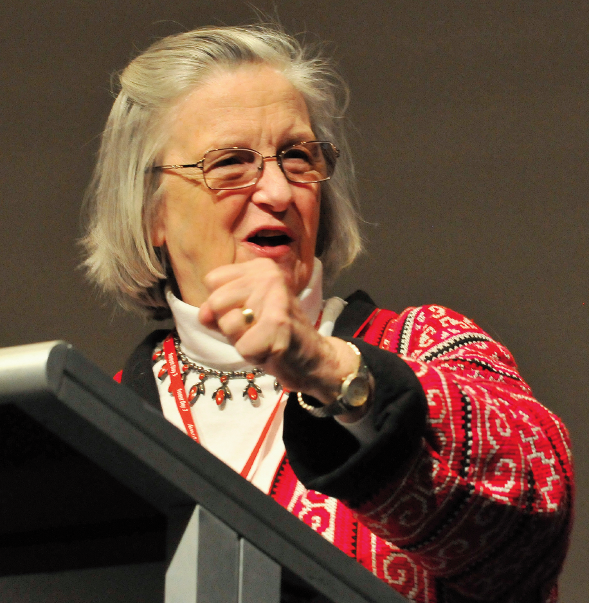
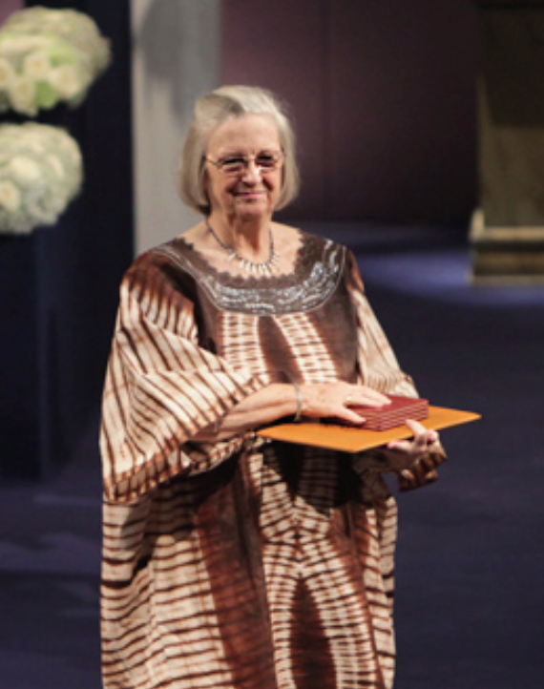
Elinor Ostrom (1933-2012)
She was professor of political science
at Indiana University (USA)
and the only woman
who has ever received the
Nobel prize in economic sciences.

Slide 4
What research is about?
Research is a collaborative endeavour,
in both space and time, that advances through
discussions, seminars, conferences and peer-reviewed articles.
Publishing means making the research outputs
publicly available for their evaluation and use.
Peer reviewing means checking the content of articles by peers, i.e., researchers in activity (not employees of the publishers),
able to find errors and to assess originality of the results.
This guarantees
the validation, reproduction, transmission and conservation
of the research outputs for the advancement of knowledge.

Slide 5
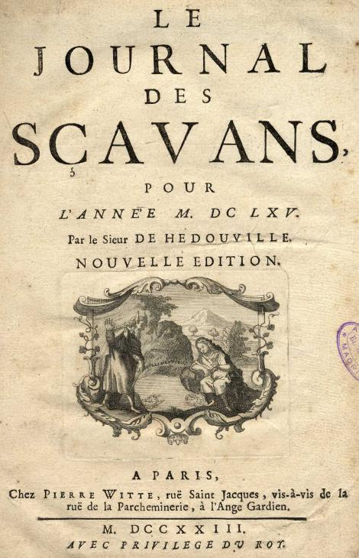
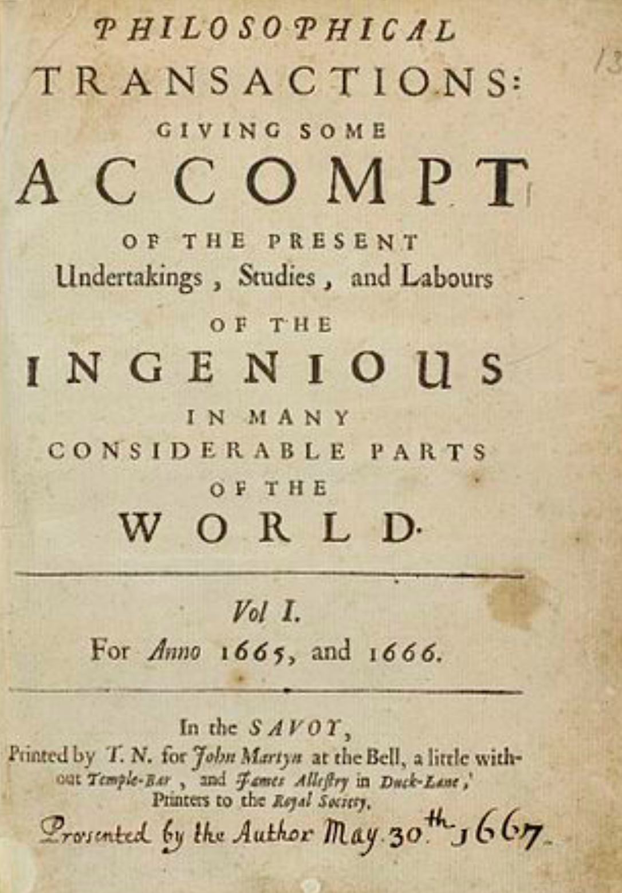
Peer-reviewed scholarly journals
The publication of research outputs in peer-reviewed journals
is the backbone of the present research system.
It was founded on January 5th 1665 for sharing ideas and results.
It is also used today for evaluating researchers and projects.
Paris, 5th January 1665
London, 6th March 1665

Slide 6
How is the scholarly publishing system today?

Slide 7
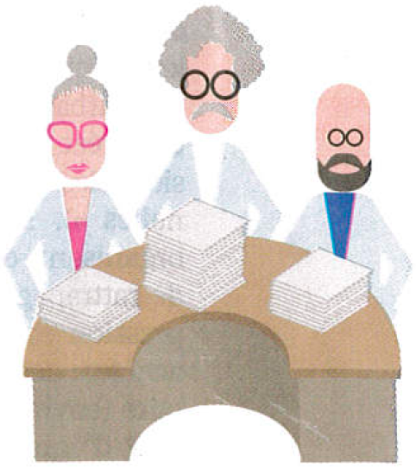
Business model of peer-reviewed journals
Taxpayers
Researchers write articles,
typeset them in final format,
review those of their peers,
are editors of scholarly journals.
Researchers
acting as editors
After papers are accepted
by reviewers and editors,
publishers put them online,
insure their visibility,
occasionally print them,
and sell them.
Their salaries
are paid
by taxpayers
Publishers
Librarians negociate subscription contracts,
pay them, control access to the journals
and curate collections of articles.

Slide 8
Publishers own articles, journals and more…
Before publishing the accepted papers,
publishers require that researchers
transfer them their copyrights for free!
Publishers own intellectual property of
the text, figures and data contained in articles
for more than 100 years. They can thus
sell articles at the prices and conditions
they set, with non-disclosable contracts.
Publishers also own the scholarly journals,
plus all derivatives (e.g., databases), plus the
peer-reviewing and publishing plaftforms,
and the bibliometric data used to evaluate
research projects and researchers’ career.
Profit margin
up to 40% !

Slide 9
Authors must give their copyrights for free

Slide 10
Example of the copyright transfer form we signed on
January 24th 2017 to publish an article online in Journal of Turbulence

Slide 11
Our paper was published online on February 6th 2017 and
we then have to pay the publisher Taylor&Francis to read it
We, the authors, and anyone else,
have to pay 82 € to the publisher
to buy the right to read our article
online during 30 days only !

Slide 12
Who has access to peer-reviewed articles ?
Only researchers working in institutions and countries rich enough
to afford the very costly subscriptions to scholarly journals.
Researchers working for companies, or in poor institutions,
teachers, students, retired researchers, and all citizens who finance
public research do not have access to most of the scholarly articles.
By 2000 most of the famous scholarly journals have been bought
by few major publishers, whose exceptional profits rely on the work
that researchers and their funding agencies offer them for free.
Publishers want to benefit from the digital revolution and the Web
to develop online publishing and reduce their production costs,
while preserving their business model designed for printing.
Today few major publishers have acquired an oligopolistic position.
Vincent Larivière et al., The Oligopoly of Academic Publishers, PLOS one, 10th June 2015

Slide 13
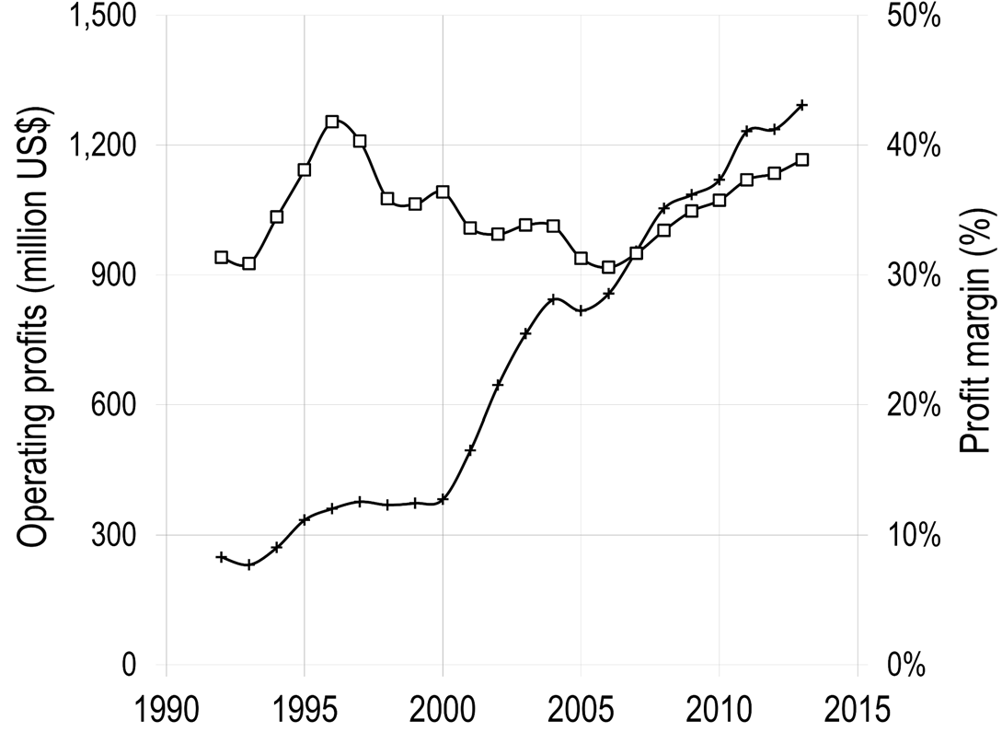
Operating profits and profit margin of the publisher Reed-Elsevier
for its Scientific, Technical and Medical (STM) division from 1990 to 2015
Operating profits
Profit margin
1.2 billion US$
Vincent Larivière et al., The Oligopoly of Academic Publishers, PLOS one, 10th June 2015

Slide 14
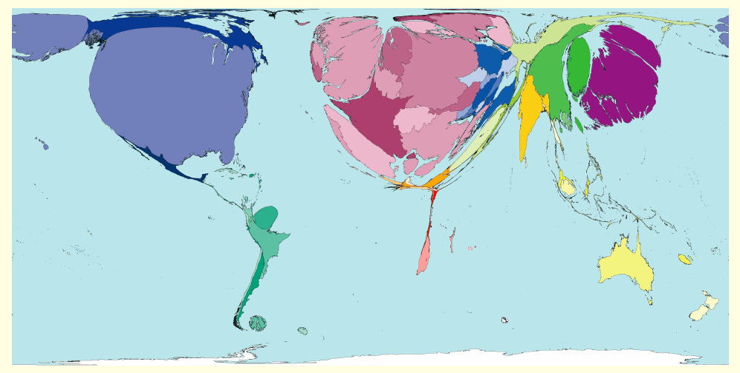
Density of peer-reviewed articles per country
Number of articles
divided by the
number of inhabitants
http://www.worldmapper.org
Today publishers impose their
Gold Open Access model,
which flips subscription costs
into article processing charges that
researchers have to pay to publish
researchers might get bankrupted
or stop publishing!
http://www.scimagoir.com

Slide 15
How could be the scholarly publishing system tomorrow?

Slide 16
What do we need publishers for ?
‘Since the creation of scientific journals 350 years ago, large commercial publishing houses have increased their control of the science system. While one could argue that their role of typesetting, printing, and diffusion were central in the print world, the ease with which these functions can be fulfilled in the electronic world makes one wonder: what do we need publishers for? […] It is up to the scientific community to change the system in a similar fashion and in parallel to the open access and open science movements. Unfortunately, researchers are still dependent on one essentially symbolic function of publishers, which is to allocate academic capital, thereby explaining why the scientific community is so dependent on The Most Profitable Obsolete Technology in History ’
Vincent Larivière et al., The Oligopoly of Academic Publishers, PLOS one, 10th June 2015

Slide 17
The marginal cost of online publishing is 0
‘While, in economic terms, printed journals can be considered as rival goods— goods that cannot be owned simultaneously by two individuals— online journals are non-rival goods : a single journal issue that has been uploaded by the publisher on the journal’ s website can be accessed by many researchers from many universities at the same time. The publisher does not have to upload or produce an additional copy each time a paper is accessed on the server as it can be duplicated ad infinitum, which in turn reduces the marginal cost of additional subscriptions to 0. In a system where the marginal cost of goods reaches 0, their cost becomes arbitrary and depends merely on how badly they are needed, as well as by the purchasing power of those who need them. […] In such a system, any price is good for the seller, as the additional unit sold is pure profit.’
Vincent Lrivière et al., The Oligopoly of Academic Publishers, PLOS one, 10th June 2015a

Slide 18
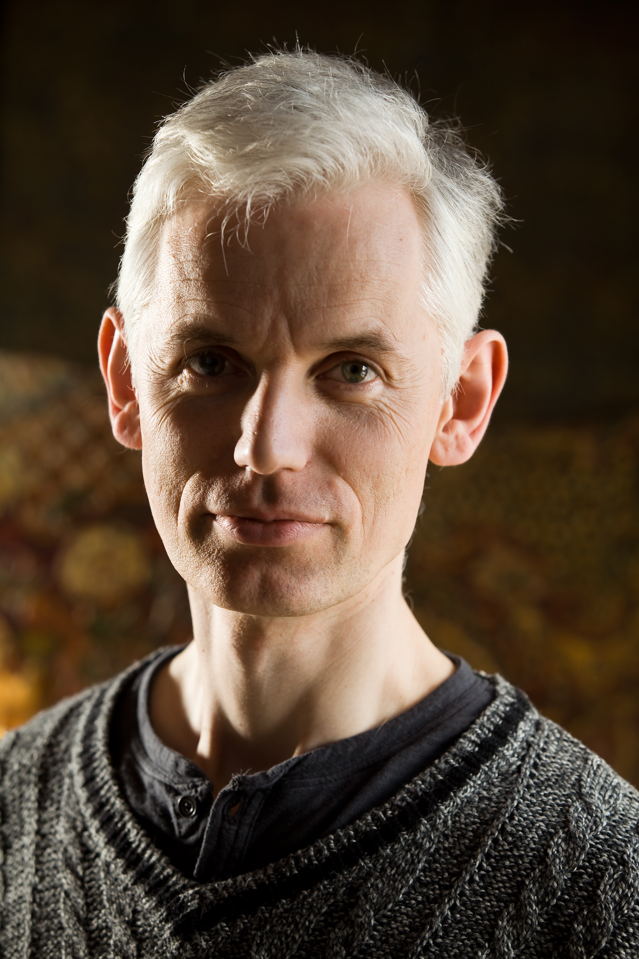
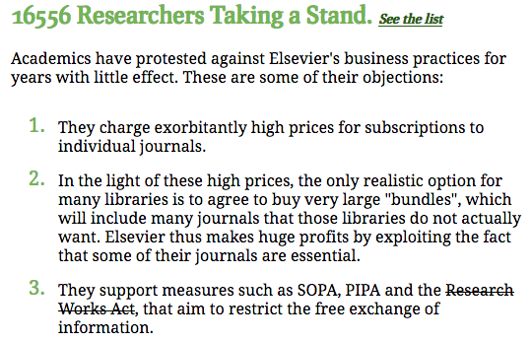
The Cost of Knowledge, 2012
Tim Gowers and 33 mathematician colleagues called to
boycott Elsevier and thus stopped the Research Works Act,
a bill to the US Congress Elsevier was lobbying for.
Sir Tim Gowers
Fields medal 1998
http://www.thecostofknowledge.com/

Slide 19
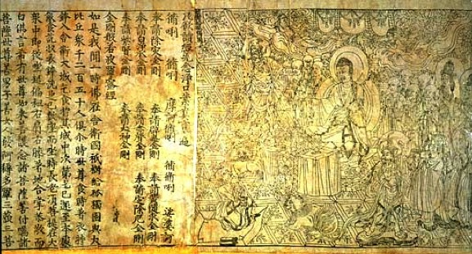
Researchers want to recover control !
`Neither author nor reader should have to pay to publish and a
journal should not belong to its publisher but to its editorial board.
The dissemination of the peer-reviewed articles should be done using
public infrastructures, from where articles should be accessible for free.’
Marie Farge, Note for the French Minister of Research, June 29th 2012
http://openscience.ens.fr/MARIE_FARGE/
Researchers proposed
an alternative model :
Diamond Open Access
Diamond Sutra,
the earliest complete survival
of a dated printed book,
China, 11th May 868
British Library, London

Slide 20
The Diamond Open Access model
1
Authors keep their copyright and make
their articles available in open access
with a Creative Commons license CC-BY.
https://creativecommons.org/licenses/
2
The editorial board owns the journal (title and assets), while
the editors and referees peer-review the articles for free,
as before since this is part as their academic duty.
3
The publisher is no more the journal’s owner but
becomes a service provider, that the editorial board
selects and hires by contract.

Slide 21
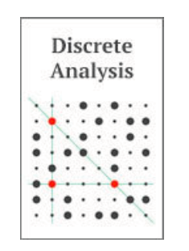
Two Diamond Open Access journals
1
//www.ipol.im ISSN : 2105-1232 DOI : 10.5201/ipol
Founded in 2010 by Jean-Michel Morel, IPOL has 41 editors.
It is financed by CNES, ERC and 13 public institutions from 5 countries.
Each article contains the text, the algorithm and the source code,
which all are peer reviewed. The journal platform also provides
online demonstration facility and an archive of experiments.
IPOL thus ensures open science and reproducible research.
2
http://discreteanalysisjournal.com ISSN : 2397-3129
Founded in 2015 by Tim Gowers, DA has 12 editors.
It is an overlay journal on the open repository arXiv.
It is financed by Cambridge University (10$/submission).

Slide 22
We need public publishing platforms
Public funding agencies should provide for free to researchers
publicly-owned platforms developed in open source software,
for peer-reviewing, publishing and archiving peer-reviewed articles,
with the help of librarians and of publishers (as subcontractors).
Anyone from anywhere would have free (gratis and libre) access to any peer-reviewed publication (e.g., articles, data, codes, videos)
without researchers having to pay to publish their results.
Funding agencies would thus control the quality of peer-reviewing,
by selecting the journals having good practices and reputable editors,
that will then be published for free.
Such publishing platforms would give the chance to researchers
to experiment new ways of publishing (e.g., open peer-reviewing).

Slide 23
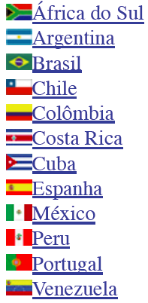
Two public publishing platforms
+
Created in 1999,
it publishes
1249 journals
in open access,
financed by public
agencies from Brazil
(FAPESP, CNPq,
BIREME) and from
15 other countries.
Created in 1999,
it publishes
451 journals
in open access,
financed by public
agencies from France
(CNRS, EHESS, BSN,
Aix-Marseille and
Avignon universities).
+

Slide 24
How to insure a smooth transition from printing on paper towards online publishing?

Slide 25
Green Open Access is the wisest model !
Today publishers own scientific journals and control bibliometry,
that they use as a marketing tool to insure their control.
The Gold Open Access model leads to the creation
of predatory journals of very poor quality, even fake journals.
To avoid this and to guarantee a smooth transition towards open access,
researchers would like to preserve the main traditional journals
which are useful, having a good reputation and good practices.
The wisest solution is the Green Open Access model, i.e.,
researchers should keep the academic freedom to publish
their articles in the journals they prefer, and at the same time
deposit a version in a public open repository.
http://openscience.ens.fr/MARIE_FARGE

Slide 26
Dissemin to boost Green Open Access
Antonin Delpeuch, a student in computer sciences from ENS Paris,
created in September 2014 the plateform http://dissem.in,
that is collectively developed in open source.
‘Spot your own paywalled papers.
Liberate them in one click!’

Slide 27
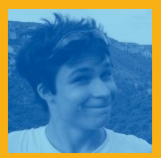
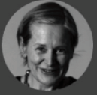
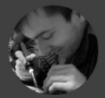
The team CAPSH / Dissemin
http://dissem.in is supported by the not-for-profit association CAPSH
(Committee for the Accessibility of Publications in Sciences and Humanities)
created on September 5th 2015 by :
Creator and main developer
of the platform Dissemin
2016
Antoine Amarilli
Pablo Rauzy
Marie Farge
Thomas Bourgeat

Slide 28
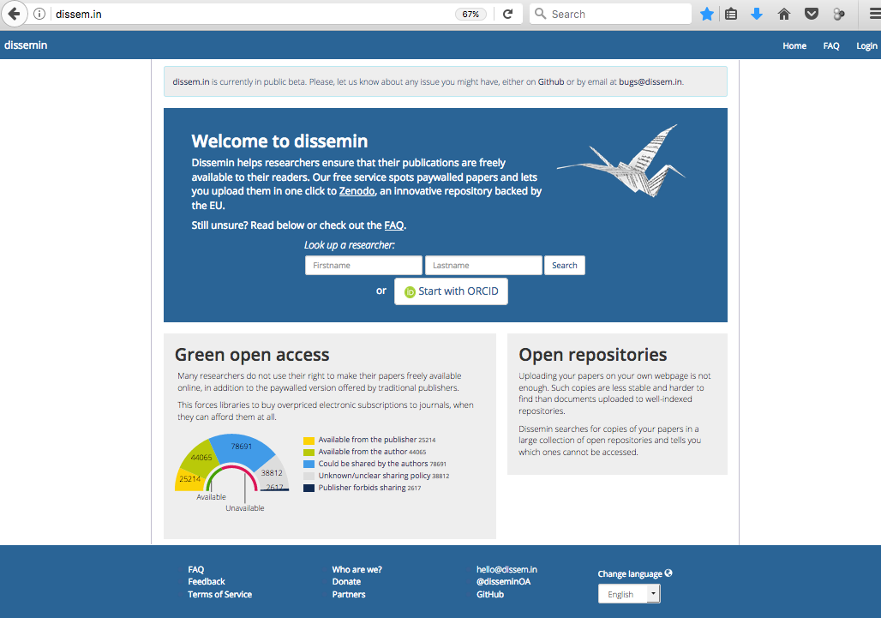
Dissemin lists the articles of any researcher

Slide 29
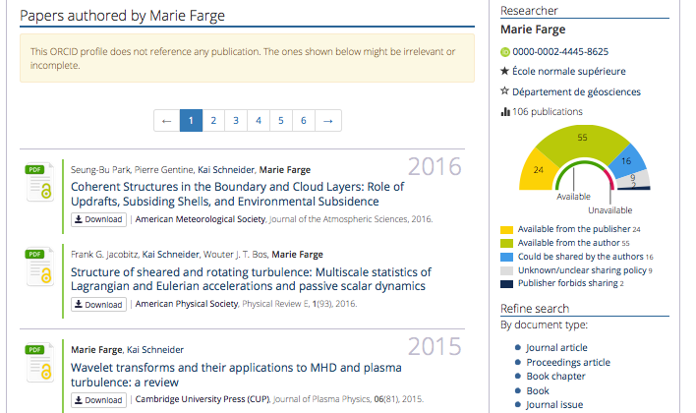
Papers already
in open access can
be downloaded :

Slide 30
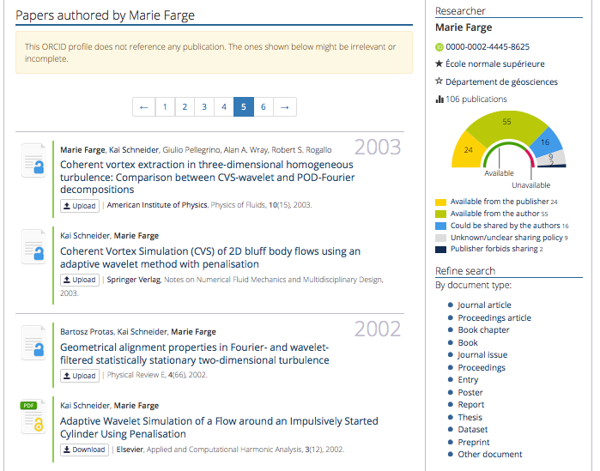
Papers not yet
in open access can
be deposited :

Slide 31
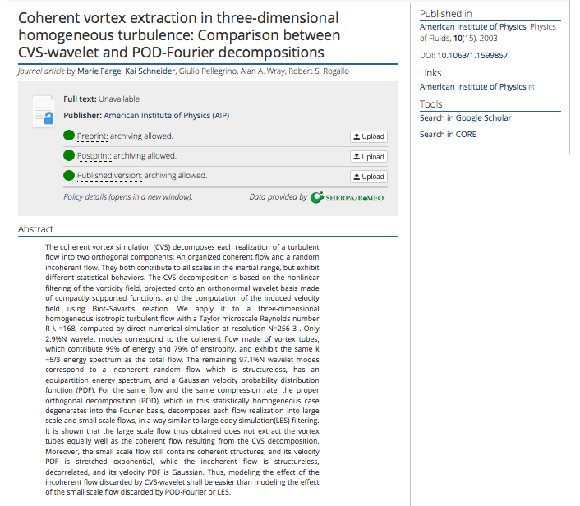
For each article
Dissemin checks
if the publisher
allows to deposit
the paper, and
which version.

Slide 32
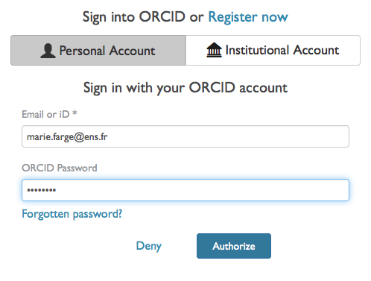
How to liberate your article from paywalls
Authors should register and identify themselves to be able to deposit their article.

Slide 33
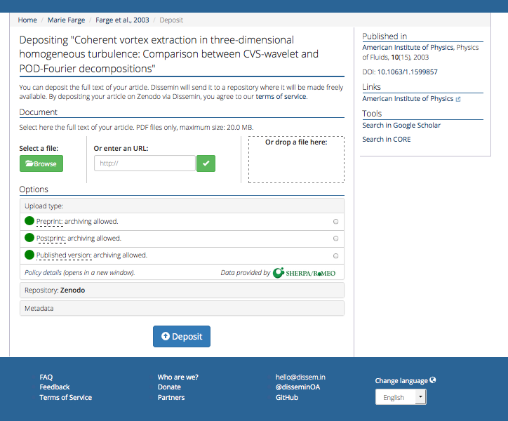
First click
to choose
the version
to deposit

Slide 34
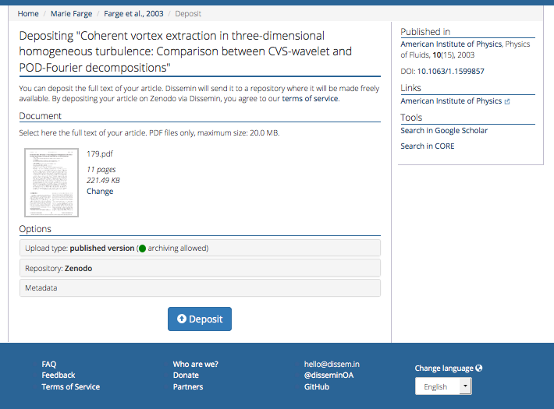
Second click
to deposit
in Zenodo

Slide 35
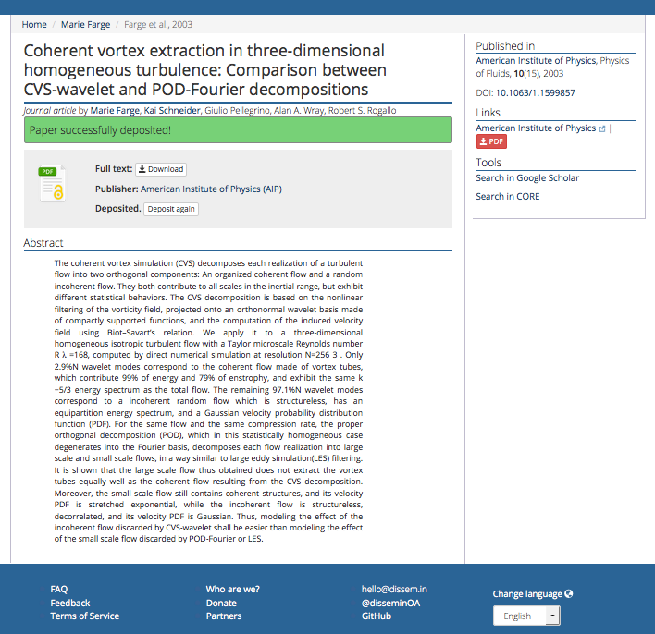
Anyone can now download
your article for free
from Zenodo,
the open repository of
CERN that is funded by
the European Commission
as part of the network
OpenAIRE.

Slide 36
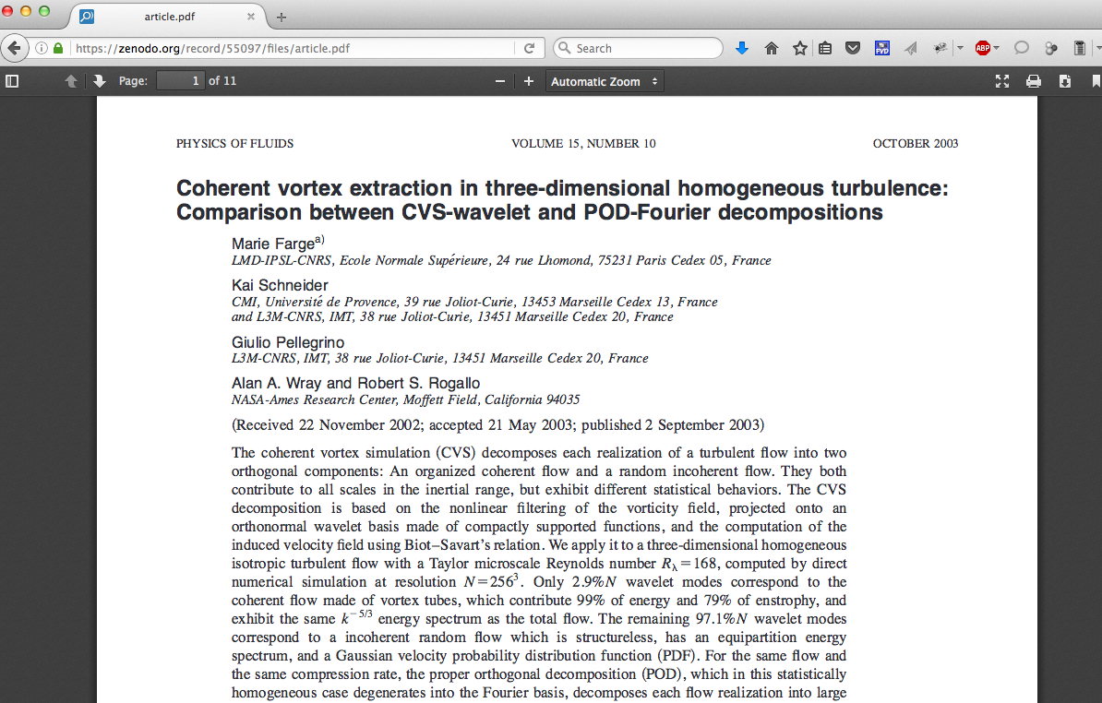
Your article is now in open access

Slide 37
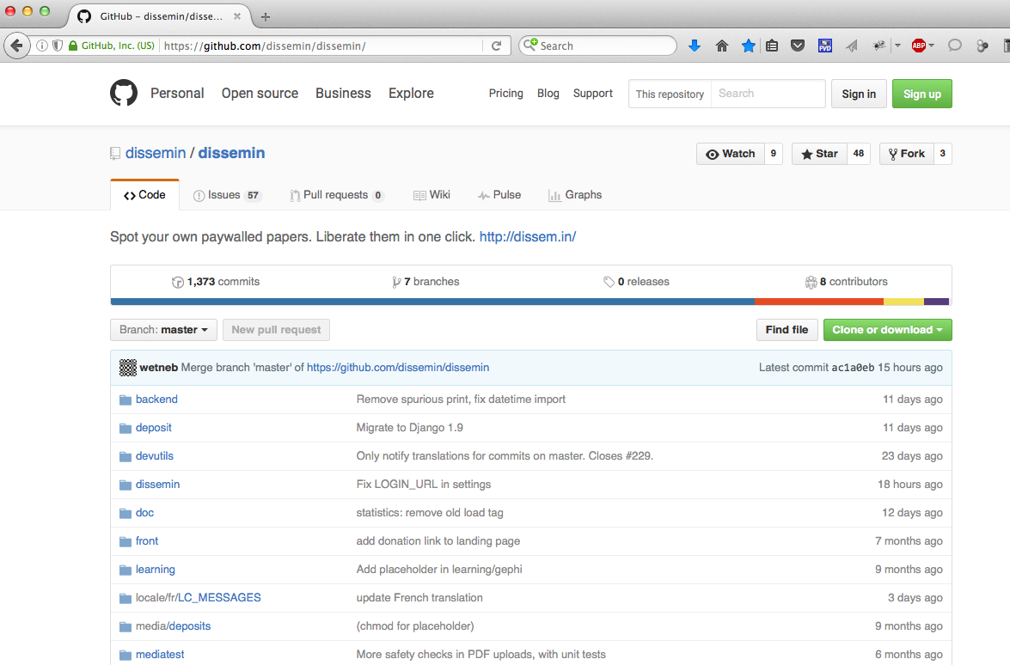
The source of Dissemin is open on GitHub

Slide 38
You can follow the development of Dissemin
Antonin
Ryan
You are also welcome to participate to its development in Python !

Slide 39
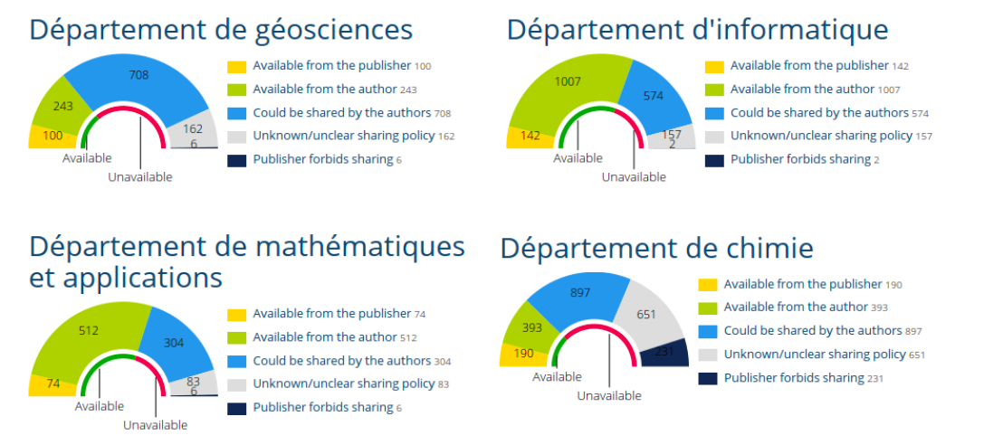
How to list the articles of an institution
With Dissemin you can generate the list of the scholarly articles
published by the researchers of an institution and get some statistics.
Here is the example of Ecole Normale Supérieure Paris :
http://dissem.in/institution/1/

Slide 40
http://dissem.in/institution/1/

Slide 41
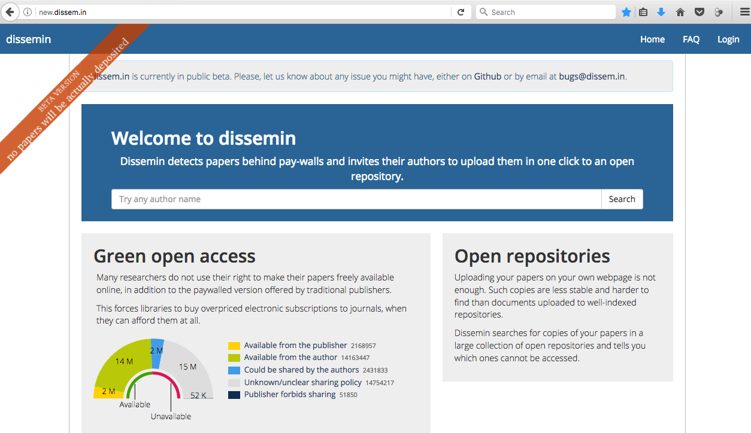
New beta version http://new.dissem.in
It harvests more than 33 M articles and offers the choice to deposit in HAL.
Interfaces for DSPACE (open source package to create open repositories)
and OSF Preprints (open repository for any discipline) are now developed.

Slide 42
Conclusion
Today investments for producing and peer-reviewing articles are public but
ownership of journals, peer-reviewing reports and publishing platforms
and profits from subscriptions, article processing charges
and bibliometric data are private.
Publishers should become service providers to
publicly funded and publicly owned publishing platforms,
without having anymore the property of articles and journals, plus
platforms for peer-reviewing, publishing, bibliometry and related data.
Public funding agencies should provide public platforms for
peer-reviewing, publishing and archiving the outputs of public research.
Intellectual property laws (copyright/copyleft) should be improved to
guarantee that research outputs remain public and open.
We need those tools to develop knowlegde as a commons.

Slide 43
'Scholarly publishing and peer-reviewing in open access’, Marie Farge, 2017
in 'Europe’s Future: Open Science, Open Innovation, and Open to the World’, European Commission, DG Research, Science and Innovation, April 2017
http://openscience.ens.fr/
http://openscience.ens.fr/MARIE_FARGE/
http://wavelets.ens.fr
http://dissem.in
http://new.dissem.in
http://association.dissem.in
https://github.com/dissemin
@disseminOA
Antonin Delpeuch <antonin@delpeuch.eu>
Marie Farge <marie.farge@ens.fr>
Team Dissemin <team@dissem.in>

